Slide 1


Slide 2

Together, we see a world where people unite and take action to create lasting change — across the globe,
in our communities,
and in ourselves.

Slide 3
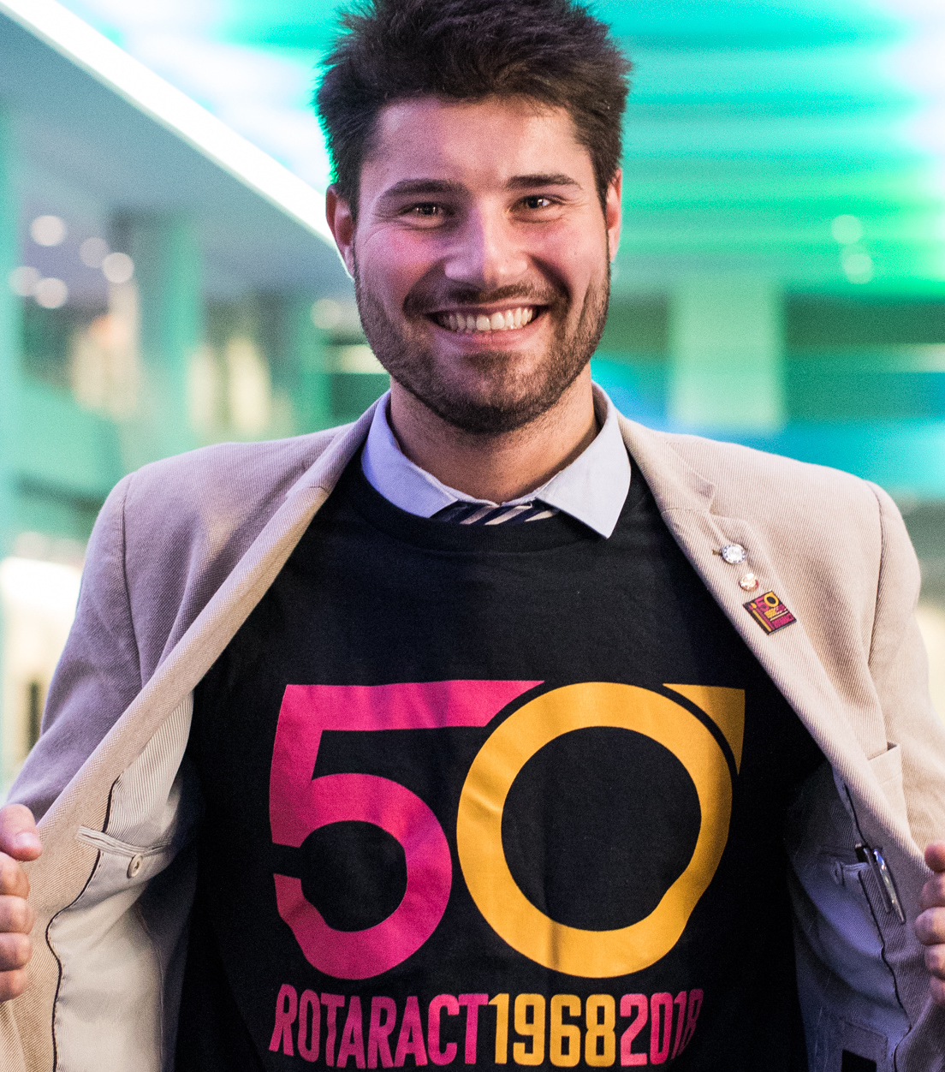
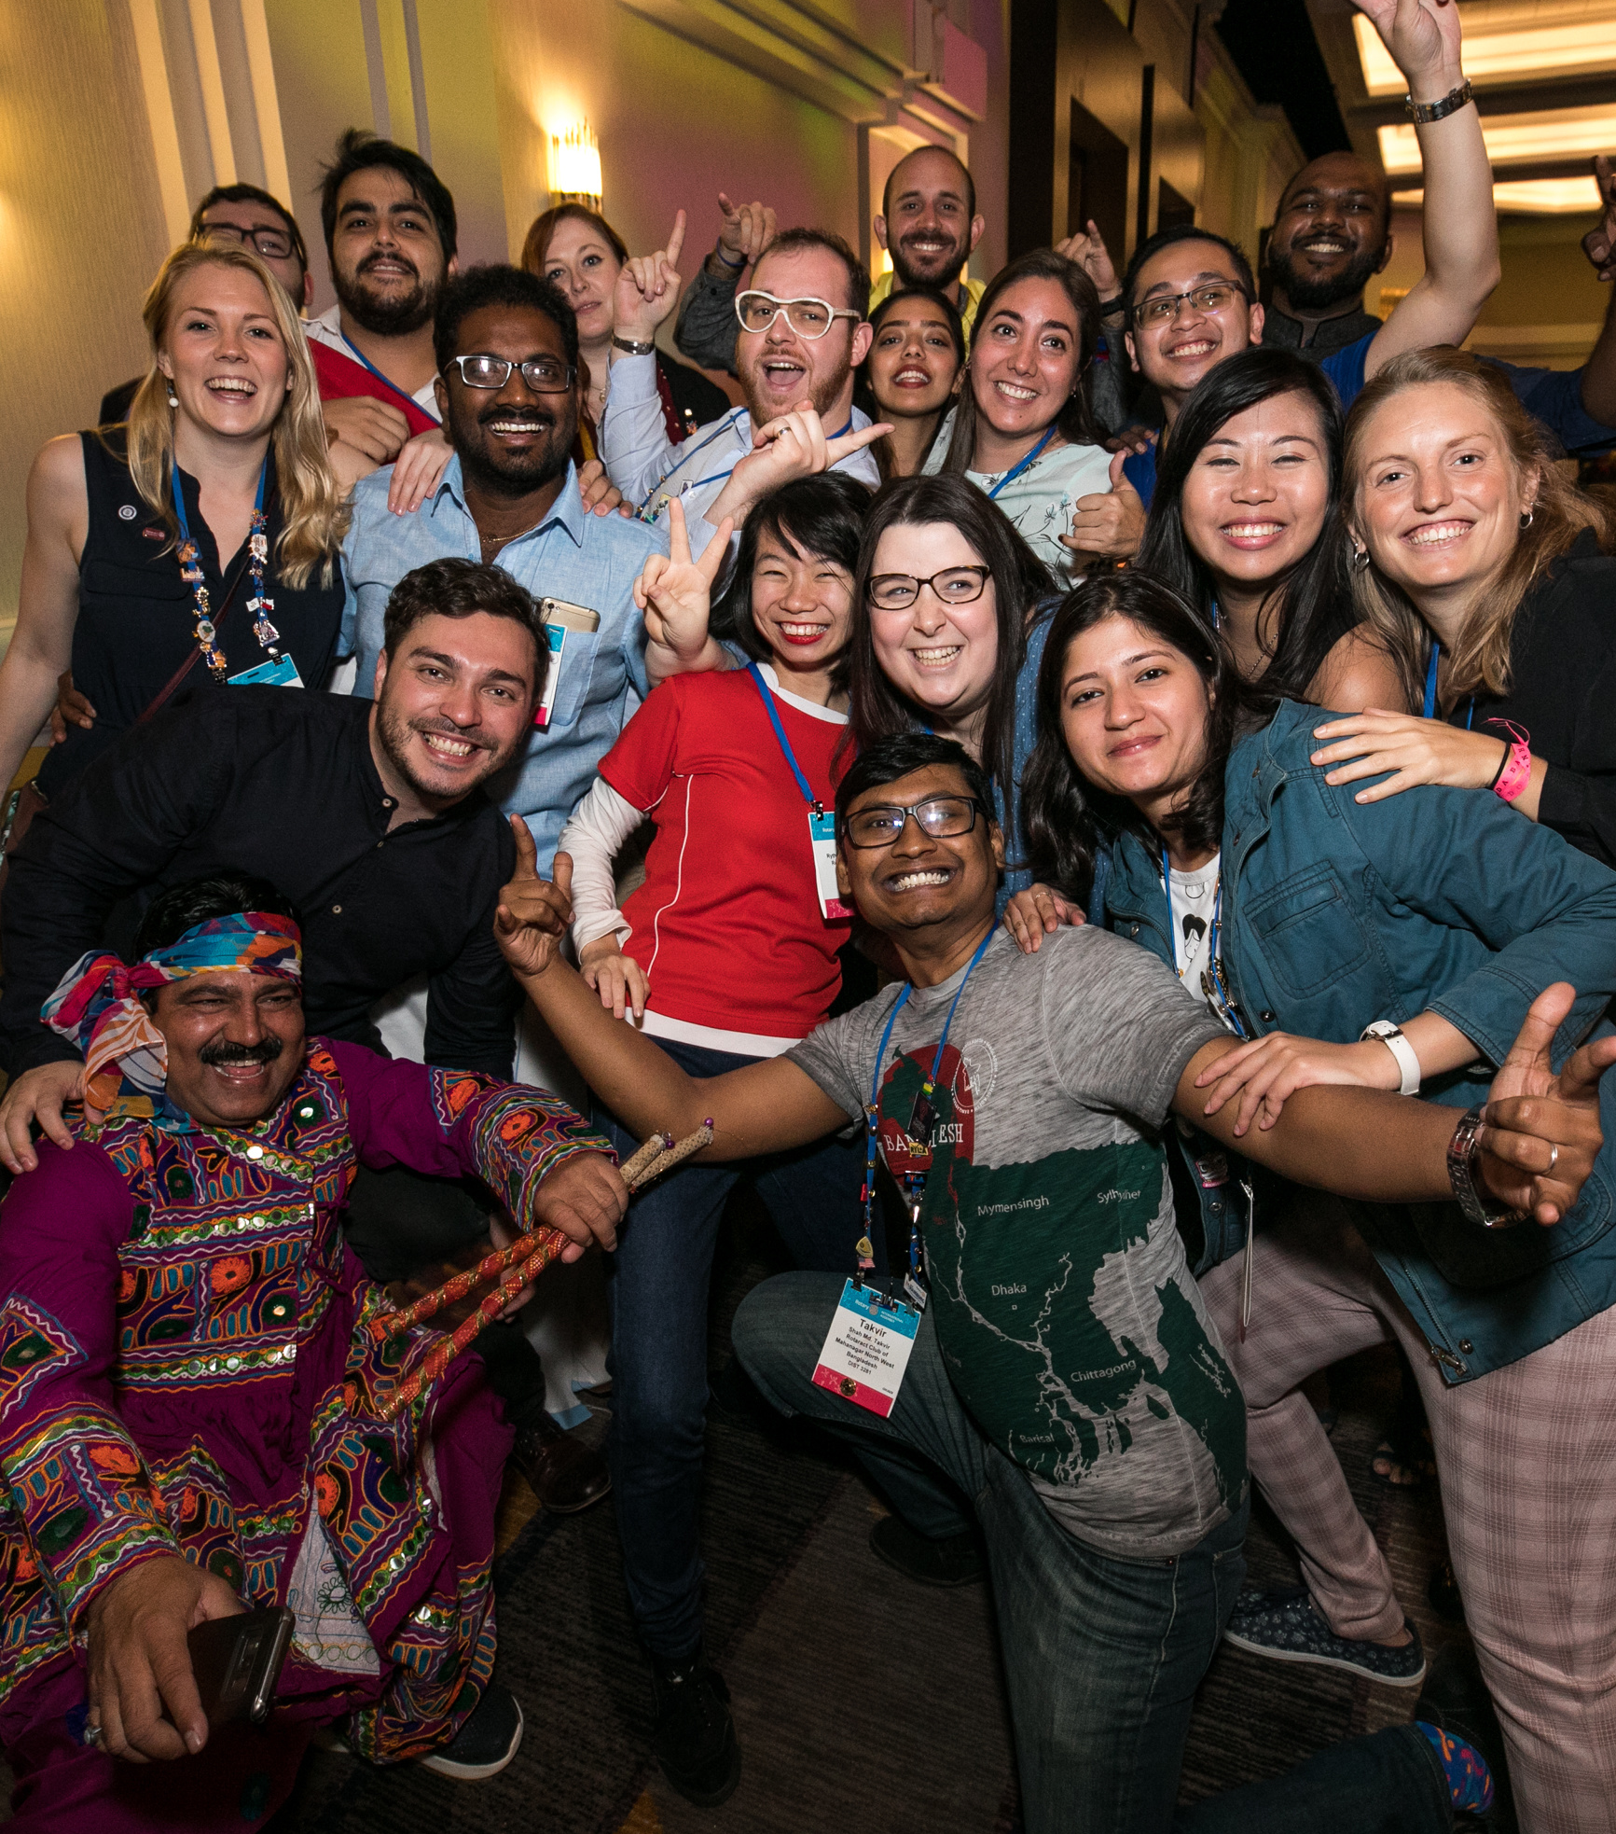
Notes:
Individually and collectively, we are People of Action.

Slide 4
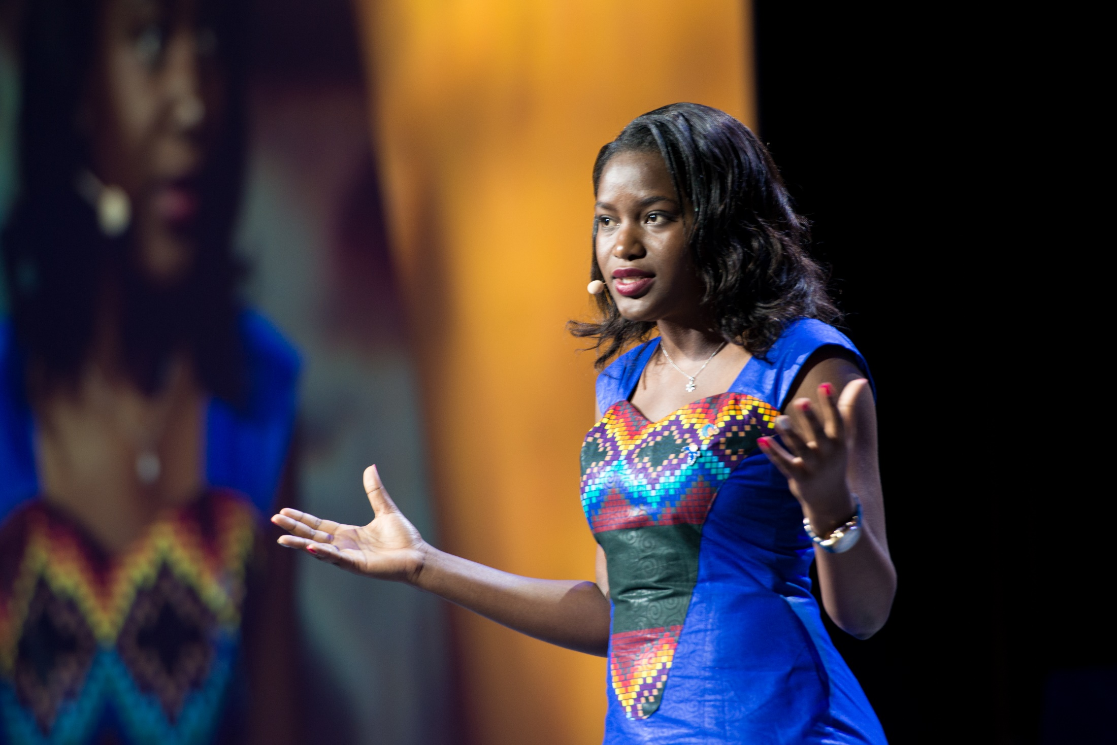
Notes:
And as People of Action, we know that fulfilling a vision requires a plan. Whenever any of us faces a big challenge in our professional lives, we don’t “tackle it without first being prepared.” We’re the ones who say, “We need a plan,” and — this is equally important — we are the ones who bring everyone together to make that plan and put it into action. I’m here to talk to you about our plan for Rotary’s future. Because we know that there’s a big gap between who we are as an organization today and who we need and want to be.

Slide 5
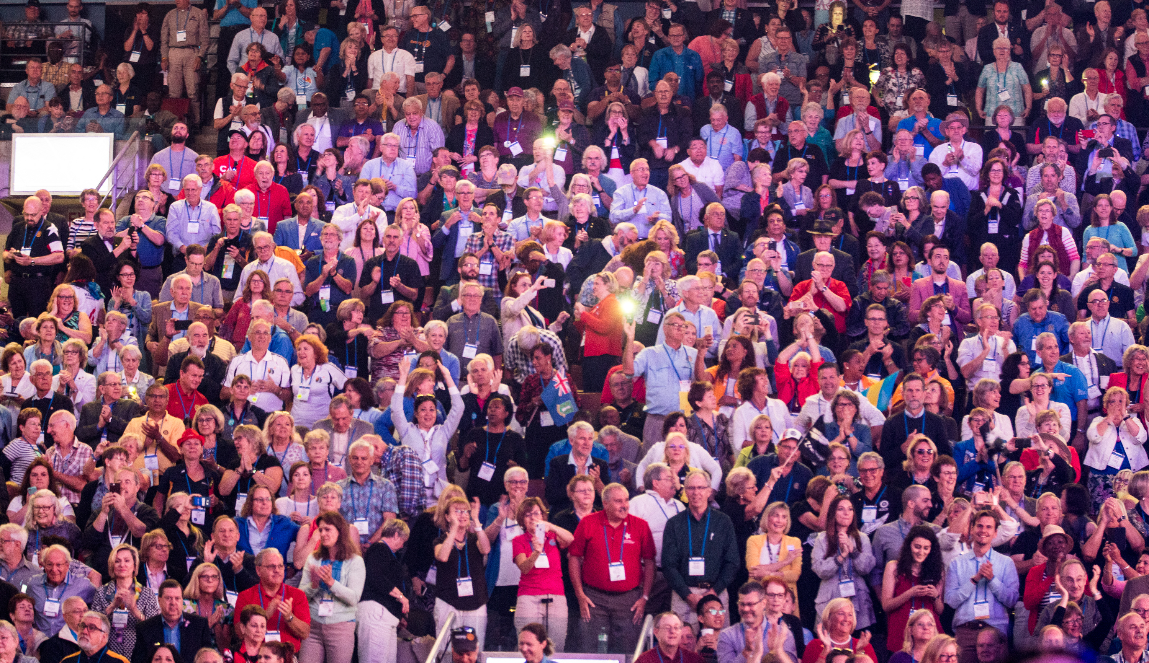
Notes:
We began developing this plan by taking a look in the mirror, asking hard questions, and making self-assessments. We conducted focus groups and surveys and asked more than a million members, leaders, and Rotary participants across the world to share their input with us. Our goals were shaped by the feedback of those who know us best — and who already share our commitment to achieving our vision. We learned that our members thought we needed to become more nimble, more open to new ideas and faces and better about capitalizing on changing technologies and trends.

Slide 6















ARG
AUS
BRA
CAN
FRA
DEU
IND
ITA
JPN
KOR
NGA
ZAF
TWN
GBR
USA
Notes:
But we knew we also had to look outside of Rotary. Here’s what we found out when we surveyed the general public in 2015. We talked to people in 15 countries around the world. We asked what would motivate them to join a service organization. Here’s what they told us:

Slide 7

Causes
Purposes
Established
reputation
Programs
Notes:
A sense of purpose and opportunity for community service.
Causes that are important to them.
An established reputation — a strong heritage.
Programs that make a difference locally.
Sounds a lot like Rotary, doesn’t it?

Slide 8
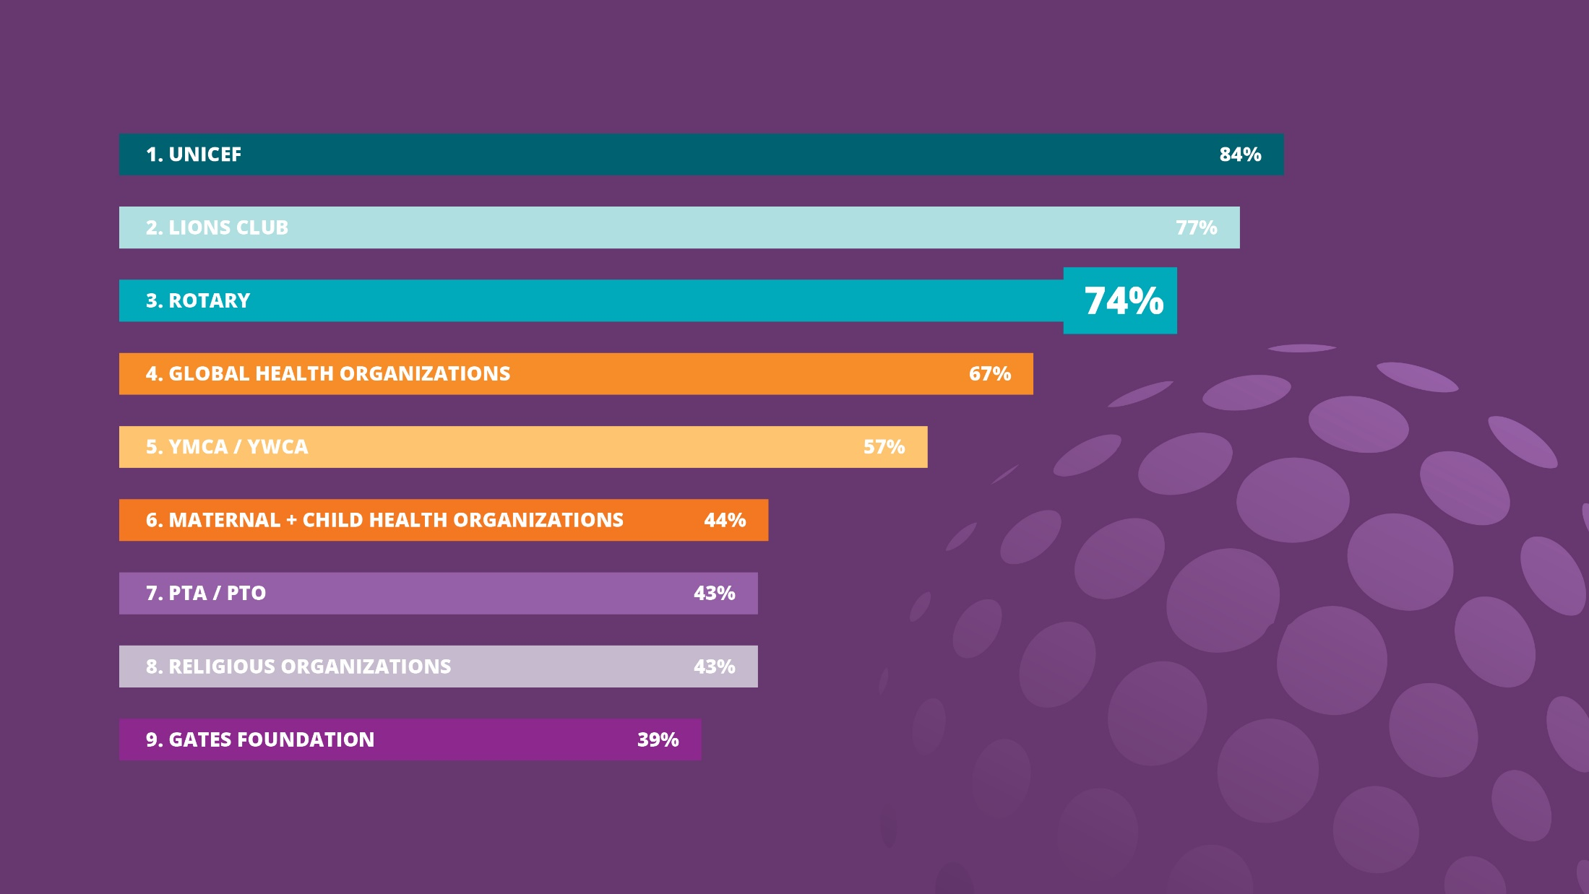
Notes:
We asked if they had heard of Rotary and found out that our global awareness is outstanding: in fact, three out of four people surveyed were aware of Rotary. Among the world’s leading social service organizations, we’re in the top 3 in terms of awareness. And people know enough about us to know that we do good in the world. Now for the challenges.

Slide 9

ONLY 35%
Rotary is an
organization for
people like me.
Notes:
Most had only a vague idea of exactly how we do good in the world. Only 35 percent saw Rotary as an organization for people like them.

Slide 10

ONLY 25%
Know someone
in Rotary
Notes:
And just 25 percent of people surveyed said they knew someone in Rotary. All of us here know how this is playing out in real life. Membership has dropped as much as 18 percent in North America and elsewhere. We set a record in 2018 for the number of people who left Rotary.

Slide 11

Notes:
As we move closer to polio eradication, we wonder: What are the new stories that will unite us, motivate us, and tell the rest of the world about our impact?

Slide 12
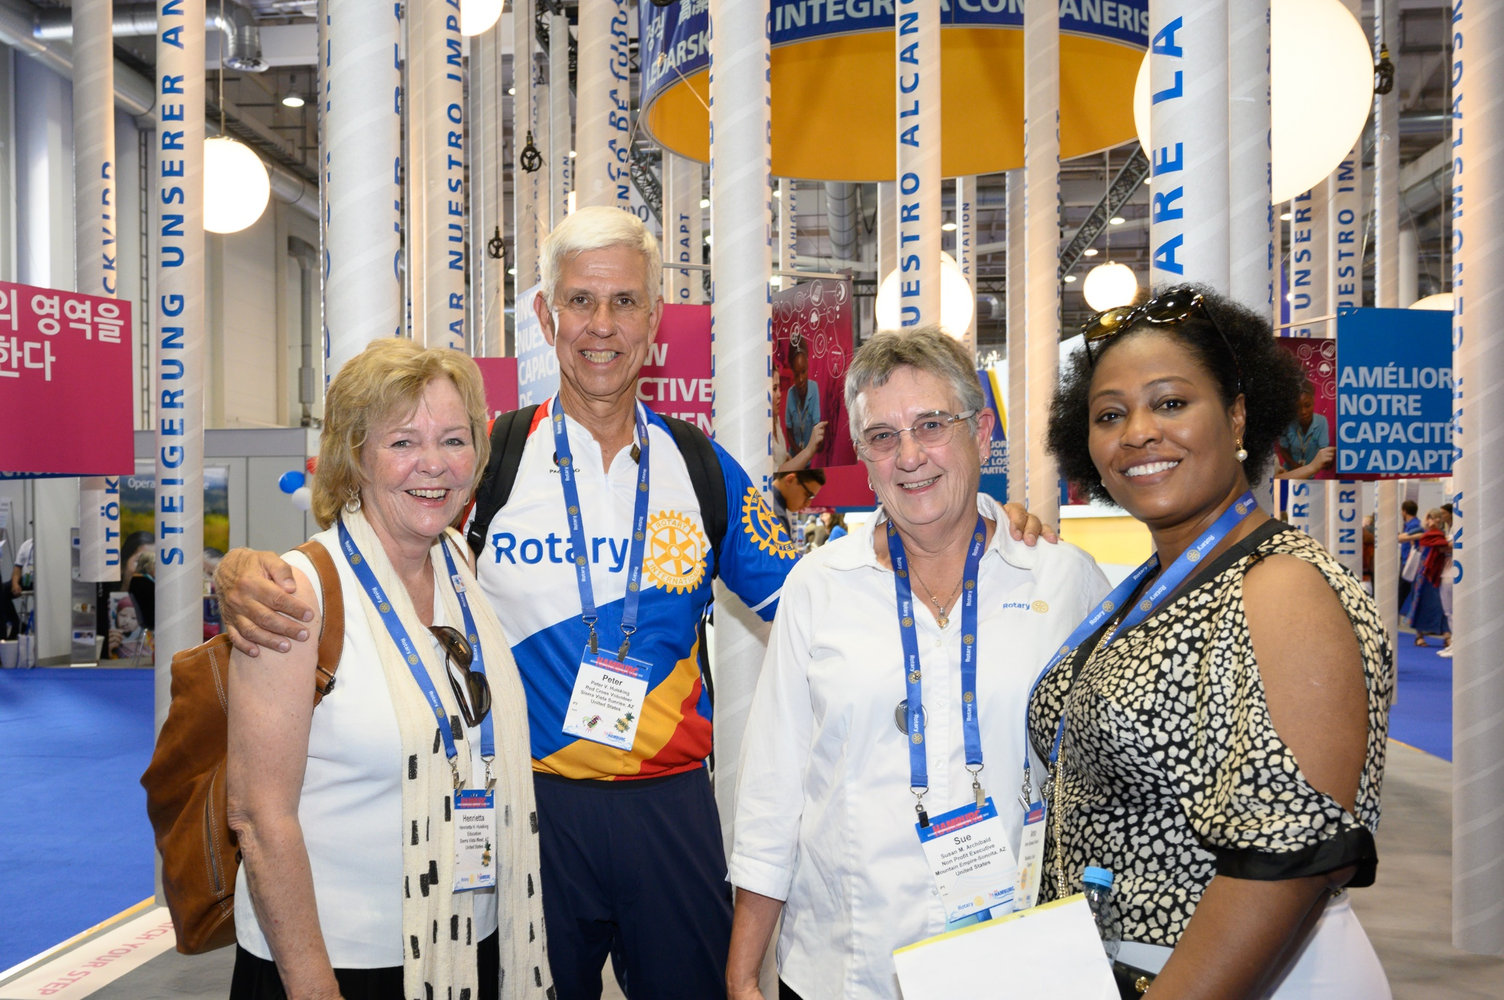
Notes:
Where is the next generation of leadership coming from? We’re in the midst of a huge demographic shift, but while the rising generations share our passion for community and for making a difference, they have plenty of other places to go to channel that passion — on their phones and in the real world.

Slide 13
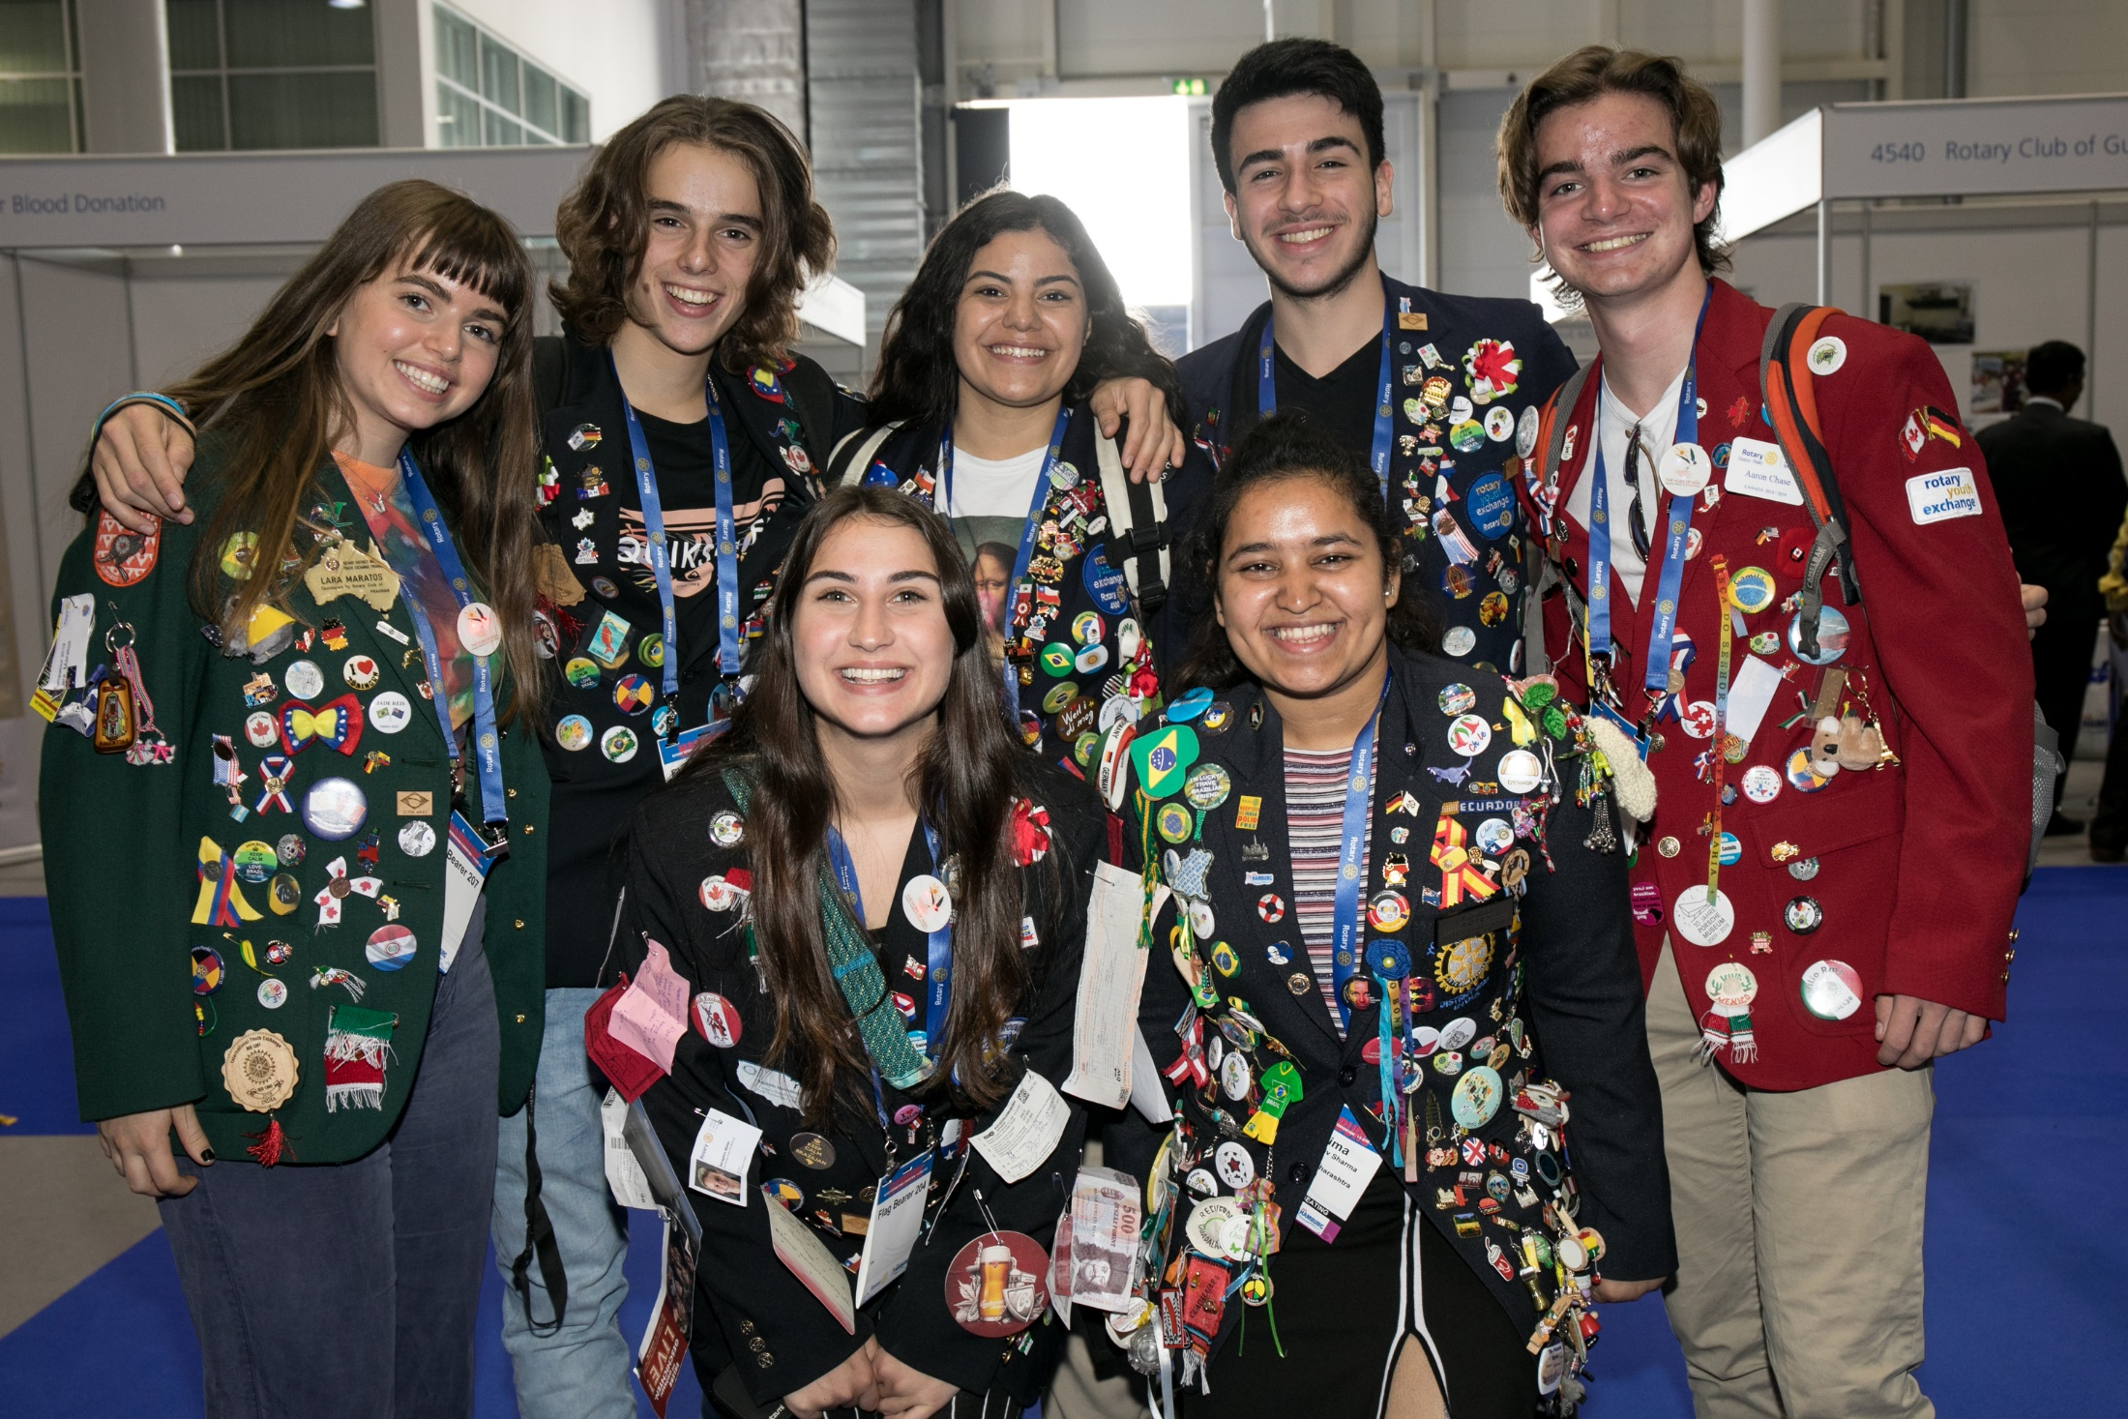
Notes:
So, here’s where we are today: we’re the undisputed pioneer of service leadership grounded in person-to-person connections — and yet we find, increasingly, people are not coming to us to make those connections. I know this isn’t easy to hear. But I have good news: We have a plan.

Slide 14


Slide 15
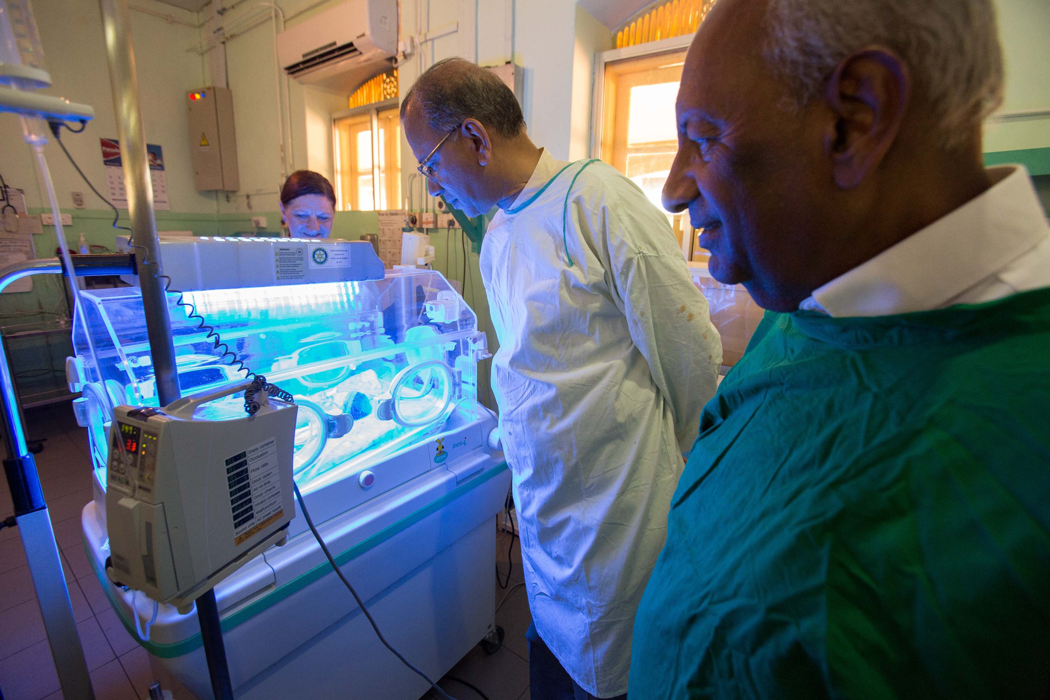
Notes:
But the Action Plan is also driven by a sense of optimism — a belief that we are and will continue to be essential to our communities, to the world, to humanity.

Slide 16
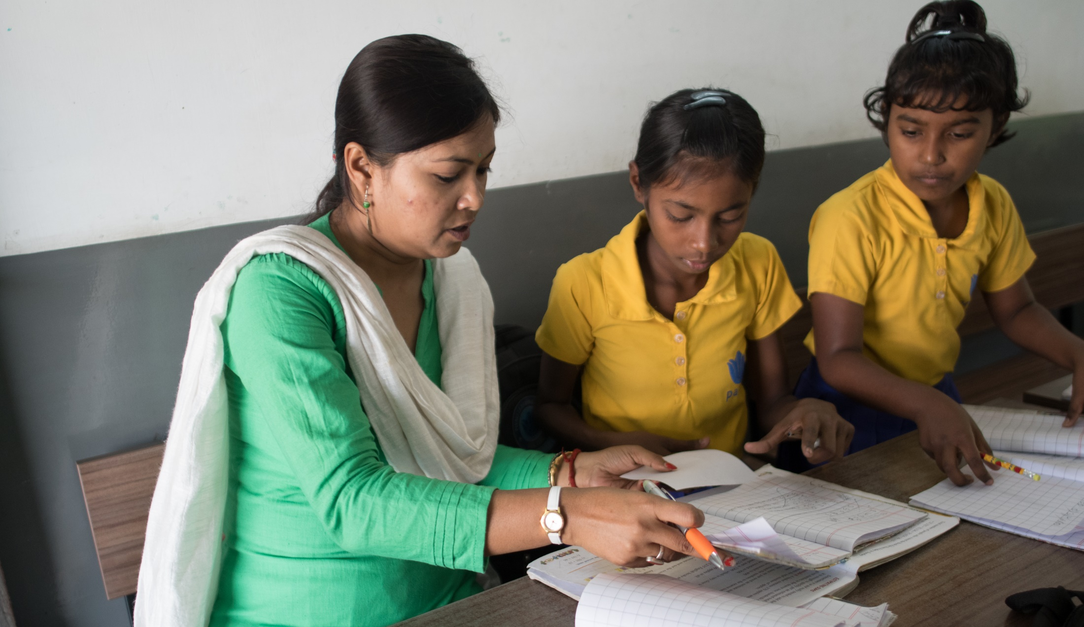
Notes:
Don’t we all want this? A stronger, more effective Rotary? A Rotary that’s more inclusive and open — to new members and to new ideas. More adept at using partnerships, digital tools, and other resources to bring people together.

Slide 17
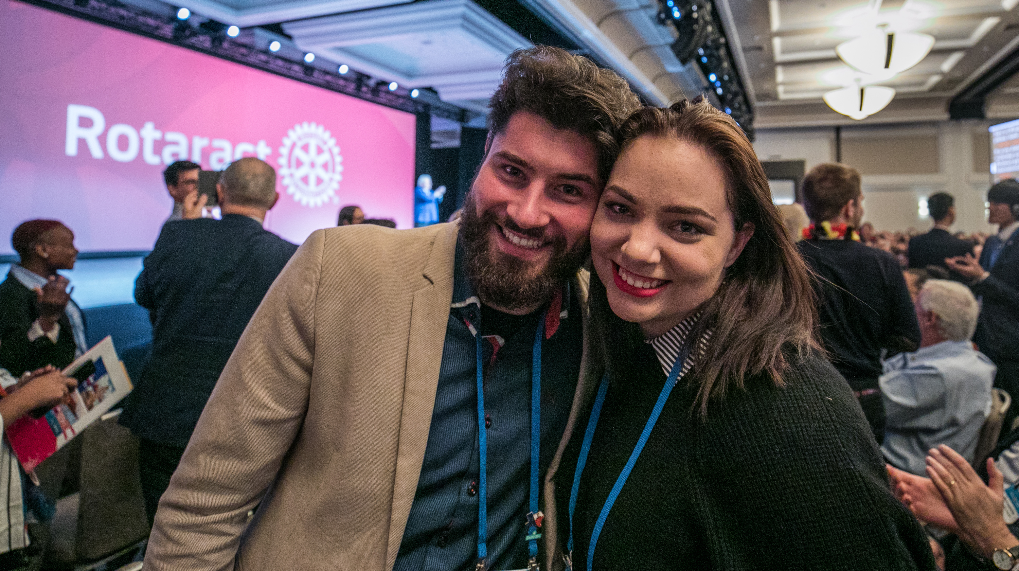
Notes:
The Action Plan helps guide how we’ll achieve this. It draws on the remarkable capabilities we’ve developed in our own professional lives and careers — above all, the capacity to listen to and learn from others. It respects that younger generations have different expectations about how to spend their time, who to spend it with, and what motivates them. And our Action Plan encourages us to use our collective, global imagination to bring fresh ideas to the forefront.
As a Rotary leader, you’ve been entrusted with a pivotal role of encouraging buy-in for the plan, and helping clubs realize our priorities over the next five years . . . a tremendous legacy for the leaders and generations who will follow you.

Slide 18

FIVE
YEARS
Notes:
This Action Plan is ambitious but achievable, with a five-year time frame that will push us but not exhaust us. It’s focused and to-the-point — like you.

Slide 19

FOUR
PRIORITIES
Notes:
It has four priorities. Four. Each priority reflects the input, feedback, and hopes of current and former members, leadership, Rotaractors, alumni, Youth Exchange students, and Rotary staff. In all, we reached out to more than a million people who are connected to Rotary in some way to ensure that our Action Plan priorities are the right ones, and are authentically Rotary. The four priorities are:

Slide 20

Increase
our impact
Expand
our reach
Enhance
participant
engagement
Increase
our ability
to adapt
Notes:
Increase our impact
Expand our reach
Enhance participant engagement, and
Increase our ability to adapt

Slide 21

From Priority to Action

Slide 22

ACTION PLAN PRIORITY 1:
INCREASE OUR IMPACT

Slide 23
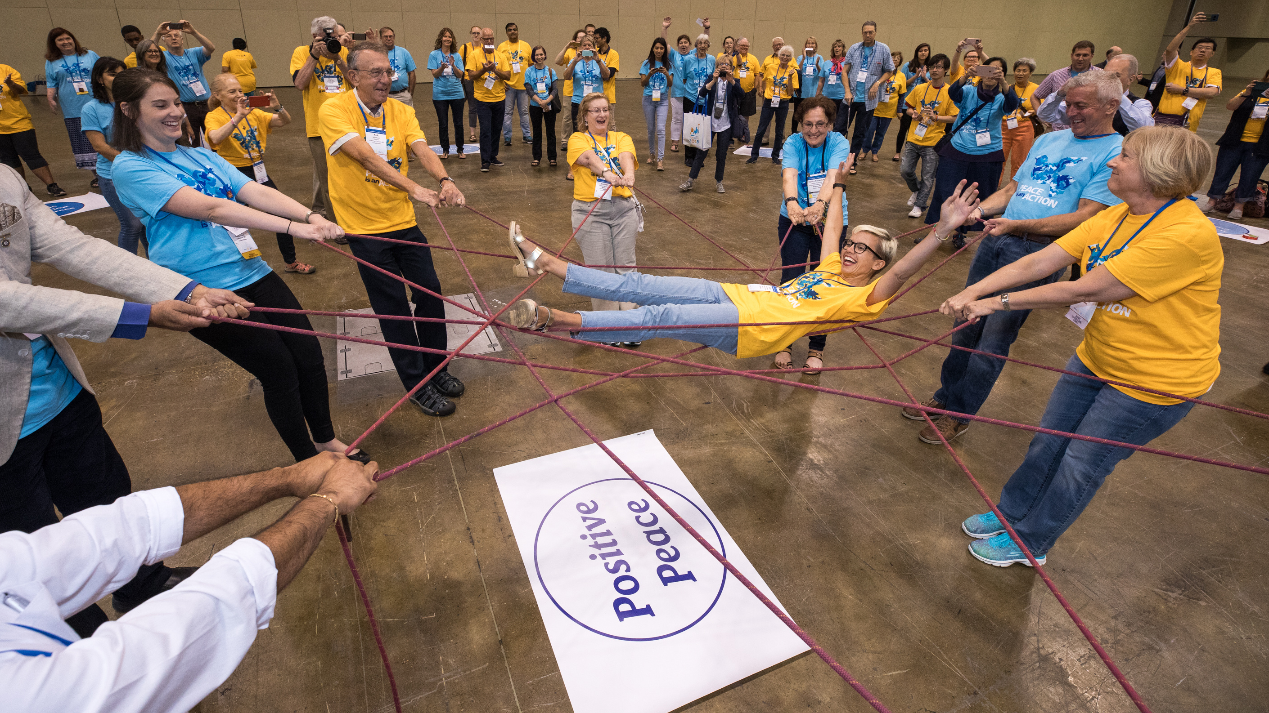
Notes:
Rotarians are effective problem-solvers who create solutions that last because we invest in relationships — what all the leadership books today call “building social capital.”

Slide 24
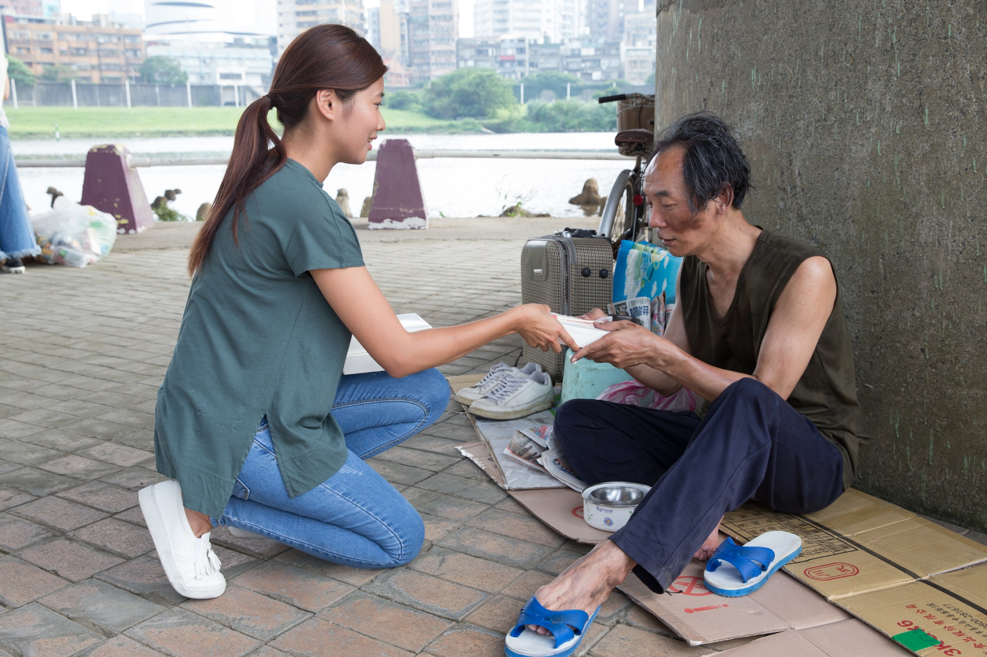
Notes:
We know how to mobilize our networks. And we are constantly learning from our experiences as we participate in clubs, volunteer in projects, and manage our careers.

Slide 25
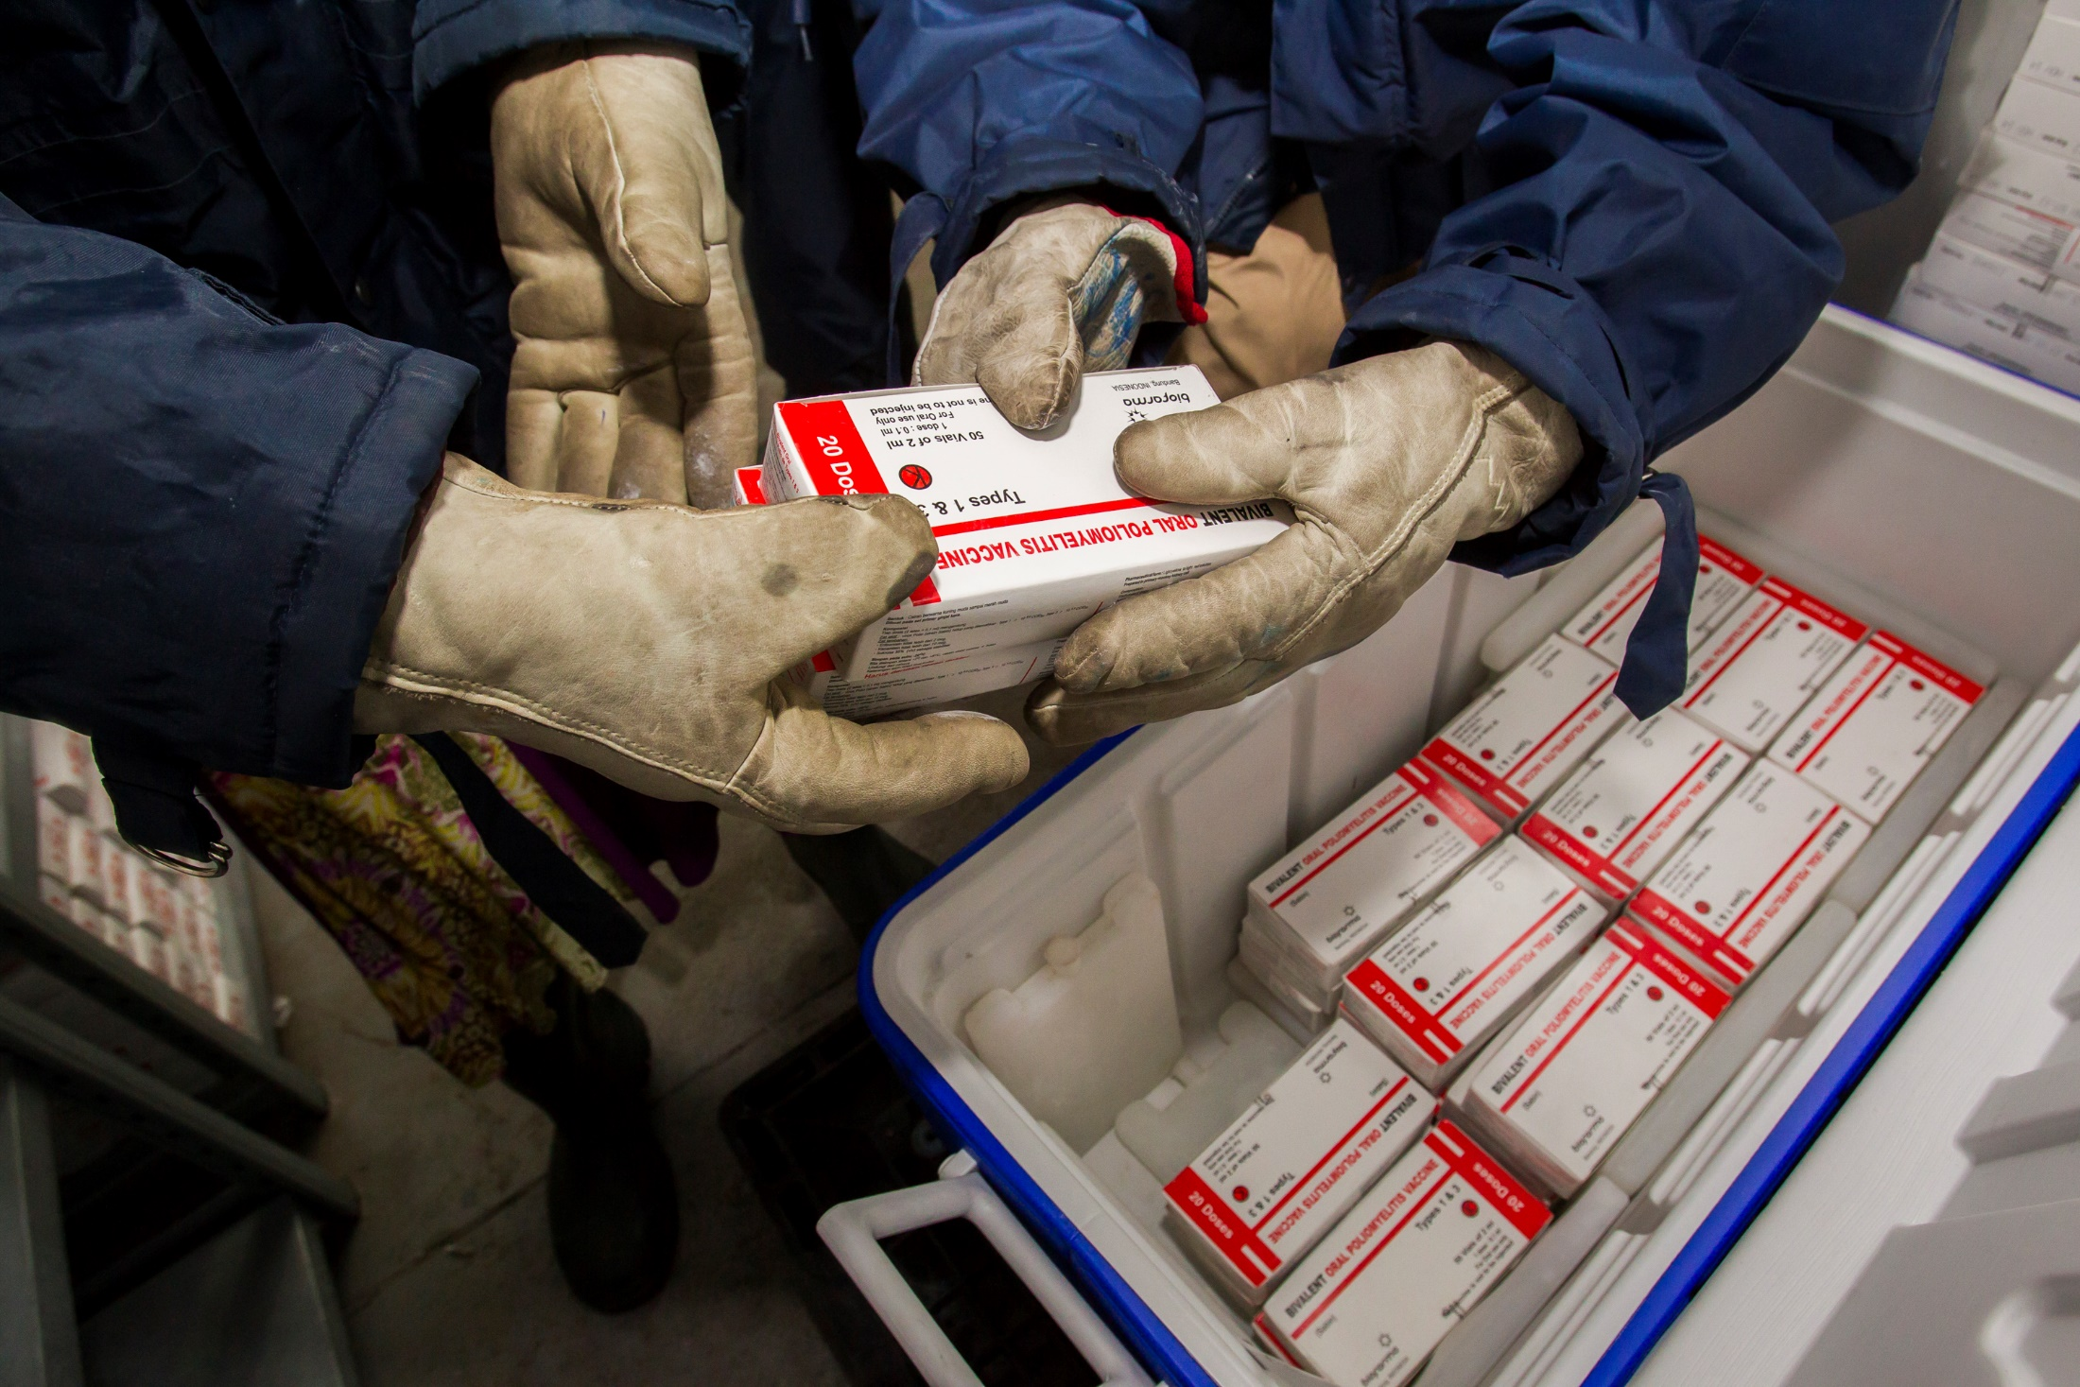
Notes:
Throughout the fight to end polio, we’ve shown what we can do when we draw on our collective strengths. We’ve created solutions customized for the people they serve. We’ve evaluated results to learn from our successes and setbacks. We’ve forged partnerships with global health partners. When we found that infrastructure was missing, we built it.

Slide 27
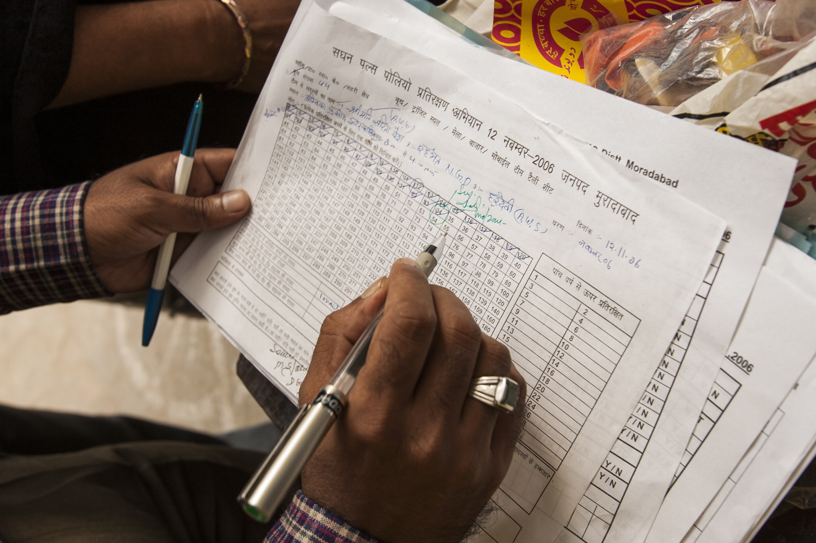
Notes:
But in a data-driven world, legacies must be measurable. To increase our impact and provide even more proof of what Rotarians are capable of achieving, we have to be more data driven.

Slide 28
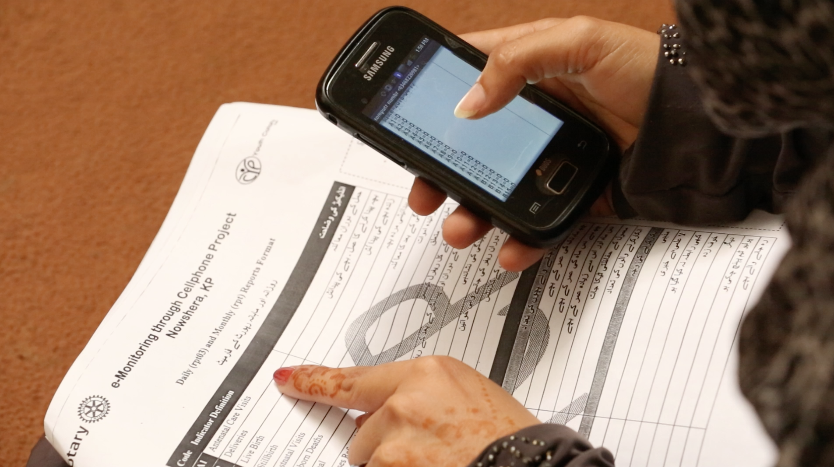
Notes:
This kind of measurement is a best practice in every sector — you probably do something like it in your own profession. And we know that current and potential partners, as well as younger Rotarians, want to see hard proof of impact. By documenting the metrics of our good works, we get a clear picture of results. We learn how to replicate and scale up our successes. And we can tell more compelling stories about the good we do.

Slide 29
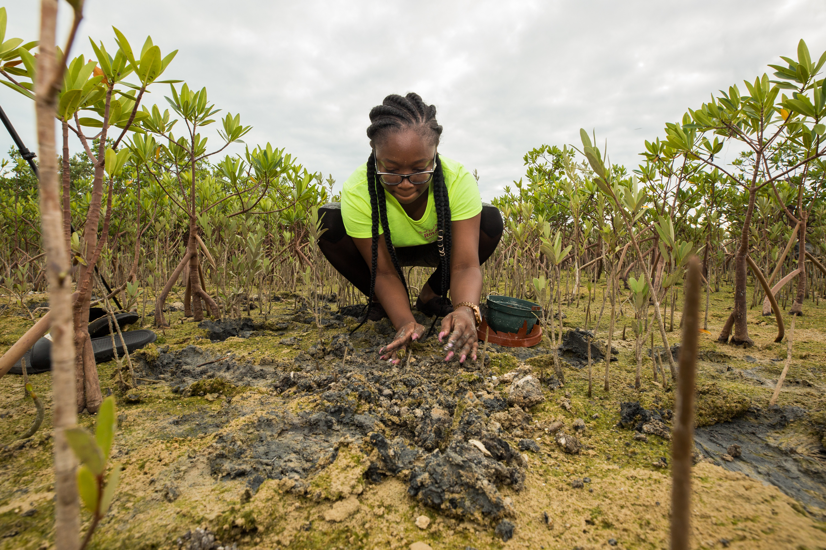
Notes:
There’s a lot we can do at the club level, too. We’re going to encourage a greater sense of focus — instead of clubs trying to do too many things and getting only halfway there. We’re going to help clubs collect more information on community impact and do pre- and post-activity evaluations, so they can tell compelling stories about the impact they are making.

Slide 30

Together, let’s prove that our impact
on the world has just begun.

Slide 31

ACTION PLAN PRIORITY 2:
EXPAND OUR REACH

Slide 32
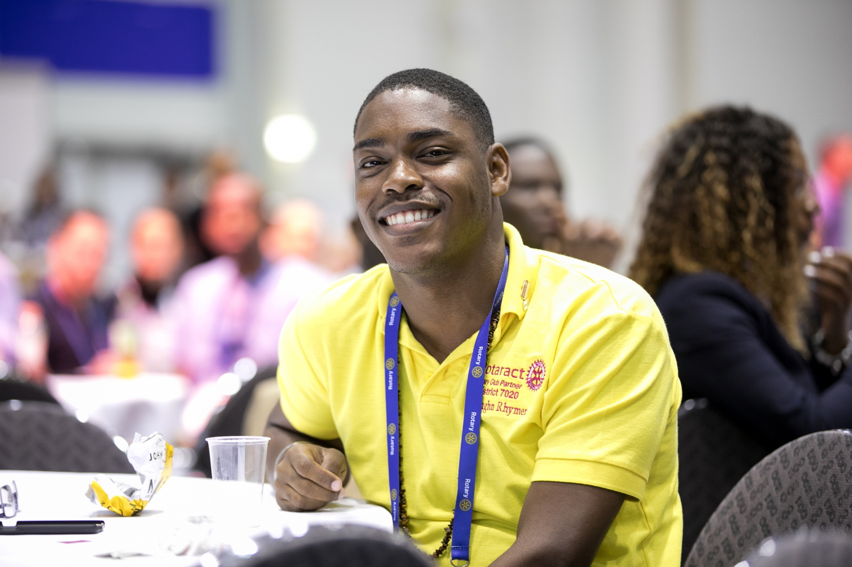
Notes:
Let’s start with those who have already shown an enthusiasm for Rotary. I’m talking about Rotaractors:

Slide 33
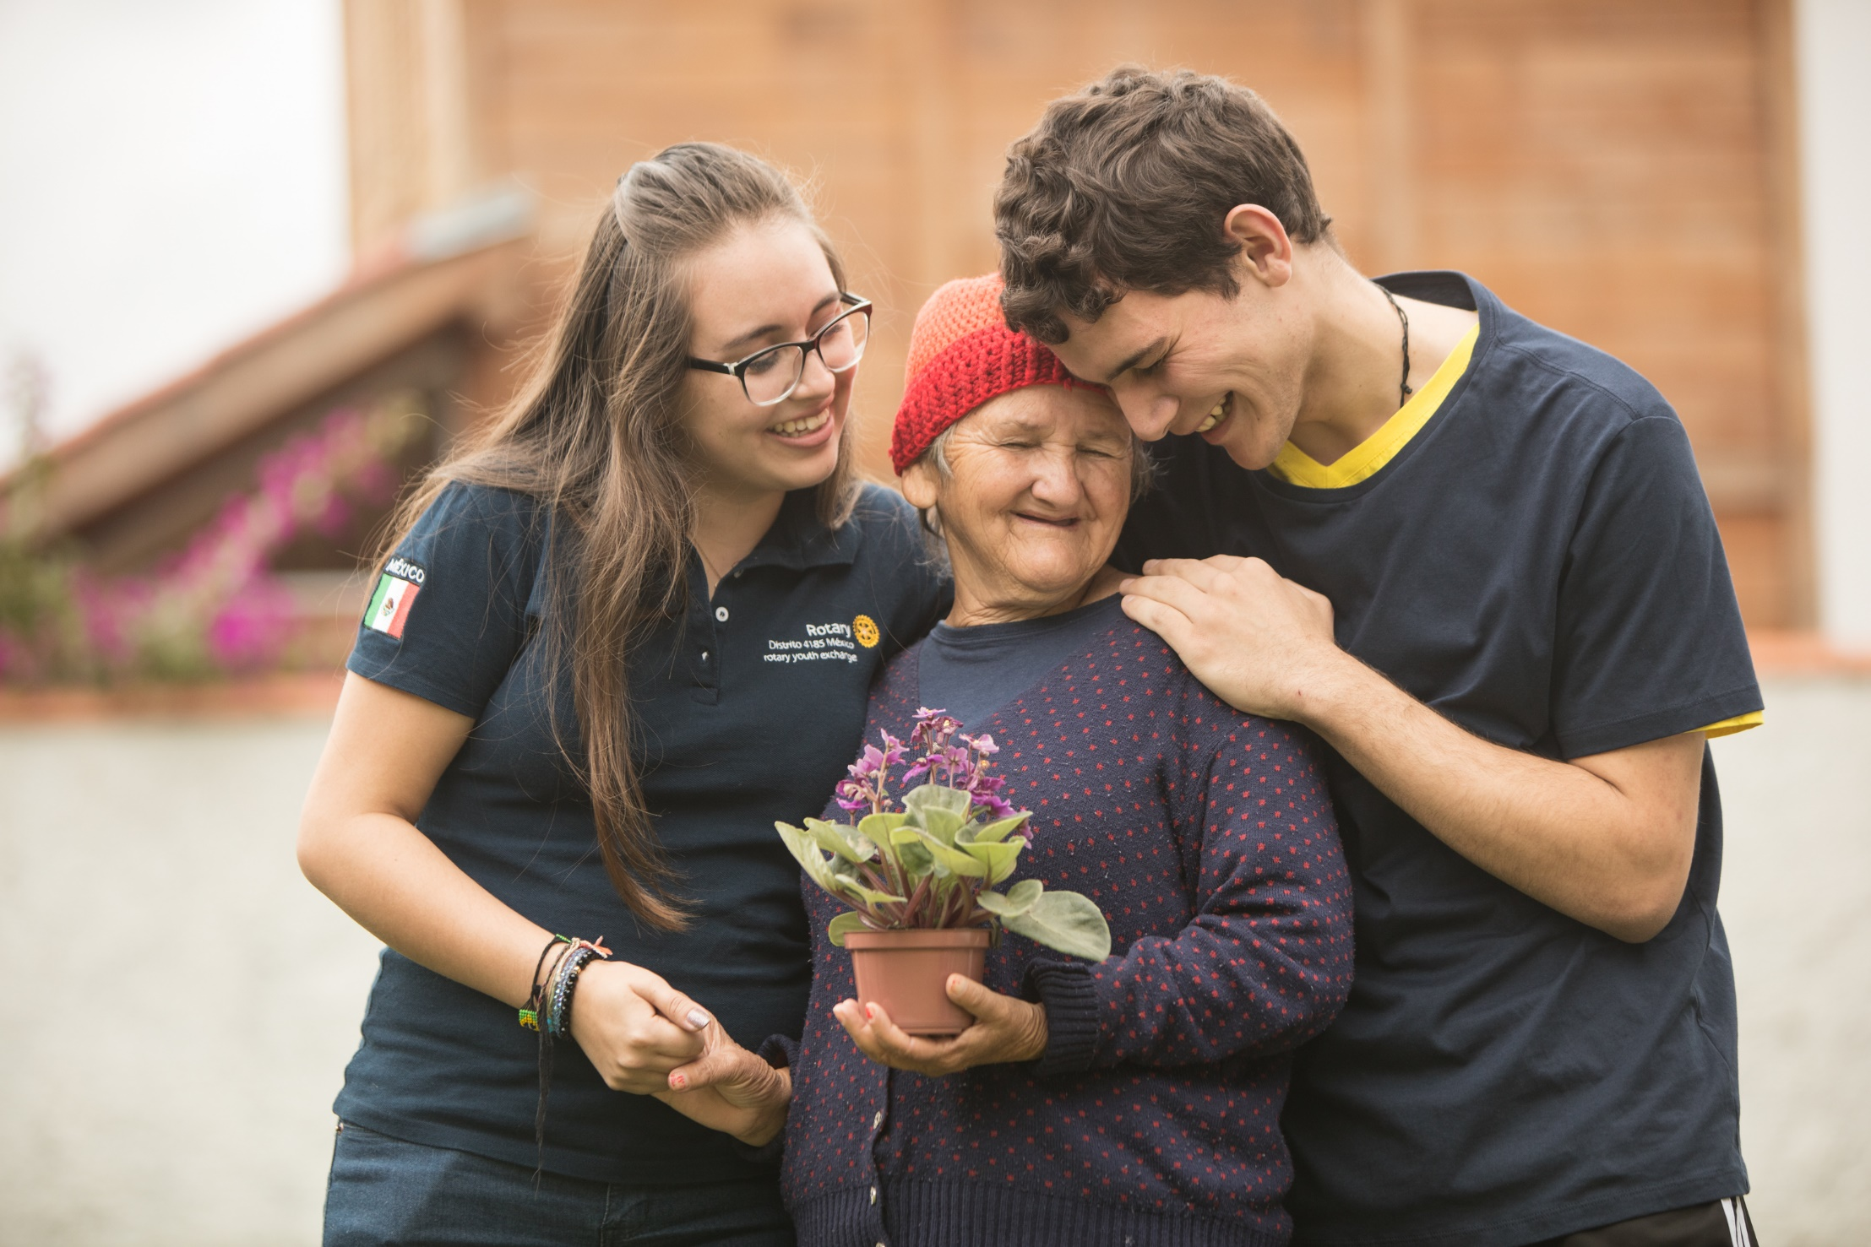
Notes:
they’re energetic, passionate, and driven community-minded professionals. They’re critical to the future of Rotary. That’s why we’re conducting research with them to find out what they want from Rotary and how we can attract others like them.

Slide 34
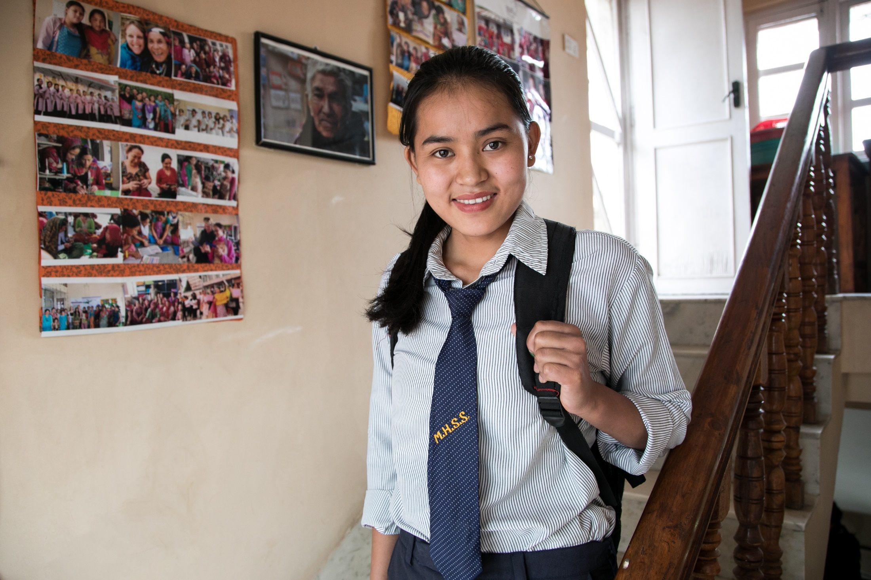
Notes:
At the corporate level, we’re developing new products and alternative participant models — so regardless of where people live, they can join us and take action with us.
At the club level, we need to actively invest in bringing in more people from different backgrounds.

Slide 35

Notes:
There are so many ways to create new channels into Rotary — bringing family members to events, involving local Rotaractors, updating clubs’ websites and social media pages.
There are all kinds of leaders in communities, and we want those leaders connected to Rotary. So let’s open up our thinking about who a leader can be, and then reach out to these new people: start a dialogue about how we can mutually benefit from their participation in our activities and events.

Slide 36
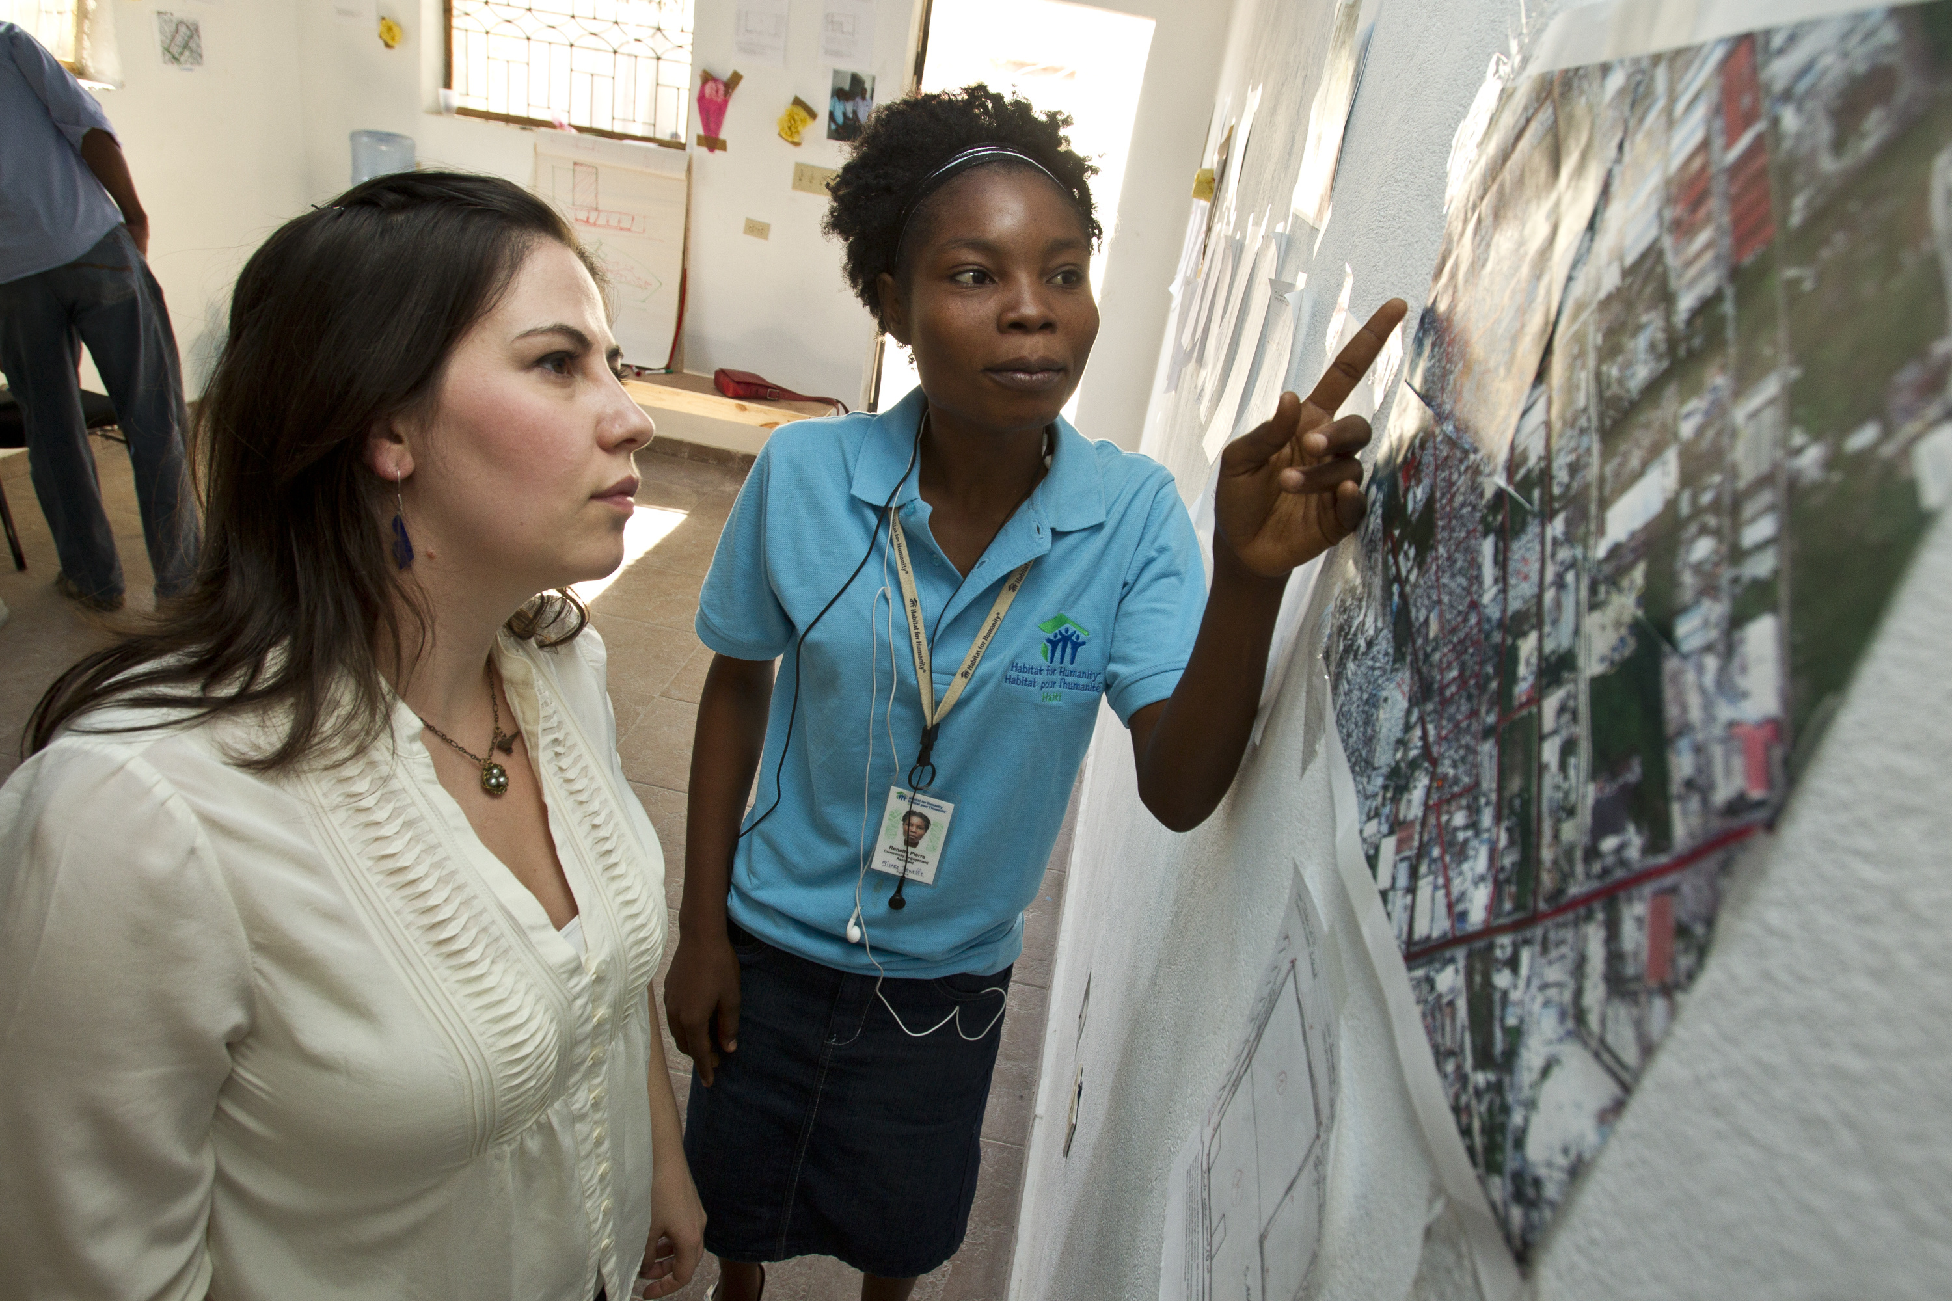
Notes:
Here’s another way to revitalize our clubs and share our values with new audiences: form partnerships with new organizations and agencies. Already, Rotary clubs partner with schools and universities, the local chamber of commerce, local governments, social service agencies, other volunteer organizations. That’s fantastic. But we need to encourage every club to do more to collaborate with and involve their communities. Let’s look around our communities and see all the ways that people are connecting — through shared professional goals, for example, or shared cultures or interests. And let’s invite those people to connect with us, too. When we think beyond traditional partnerships, we show we’re an open, engaging organization. We demonstrate that positive change starts with welcoming the talents and ideas of others.

Slide 37

Together, let’s build connections and opportunities that will allow people who
share our drive to do the same.

Slide 38

ACTION PLAN PRIORITY 3:
ENHANCE PARTICIPANT
ENGAGEMENT

Slide 39
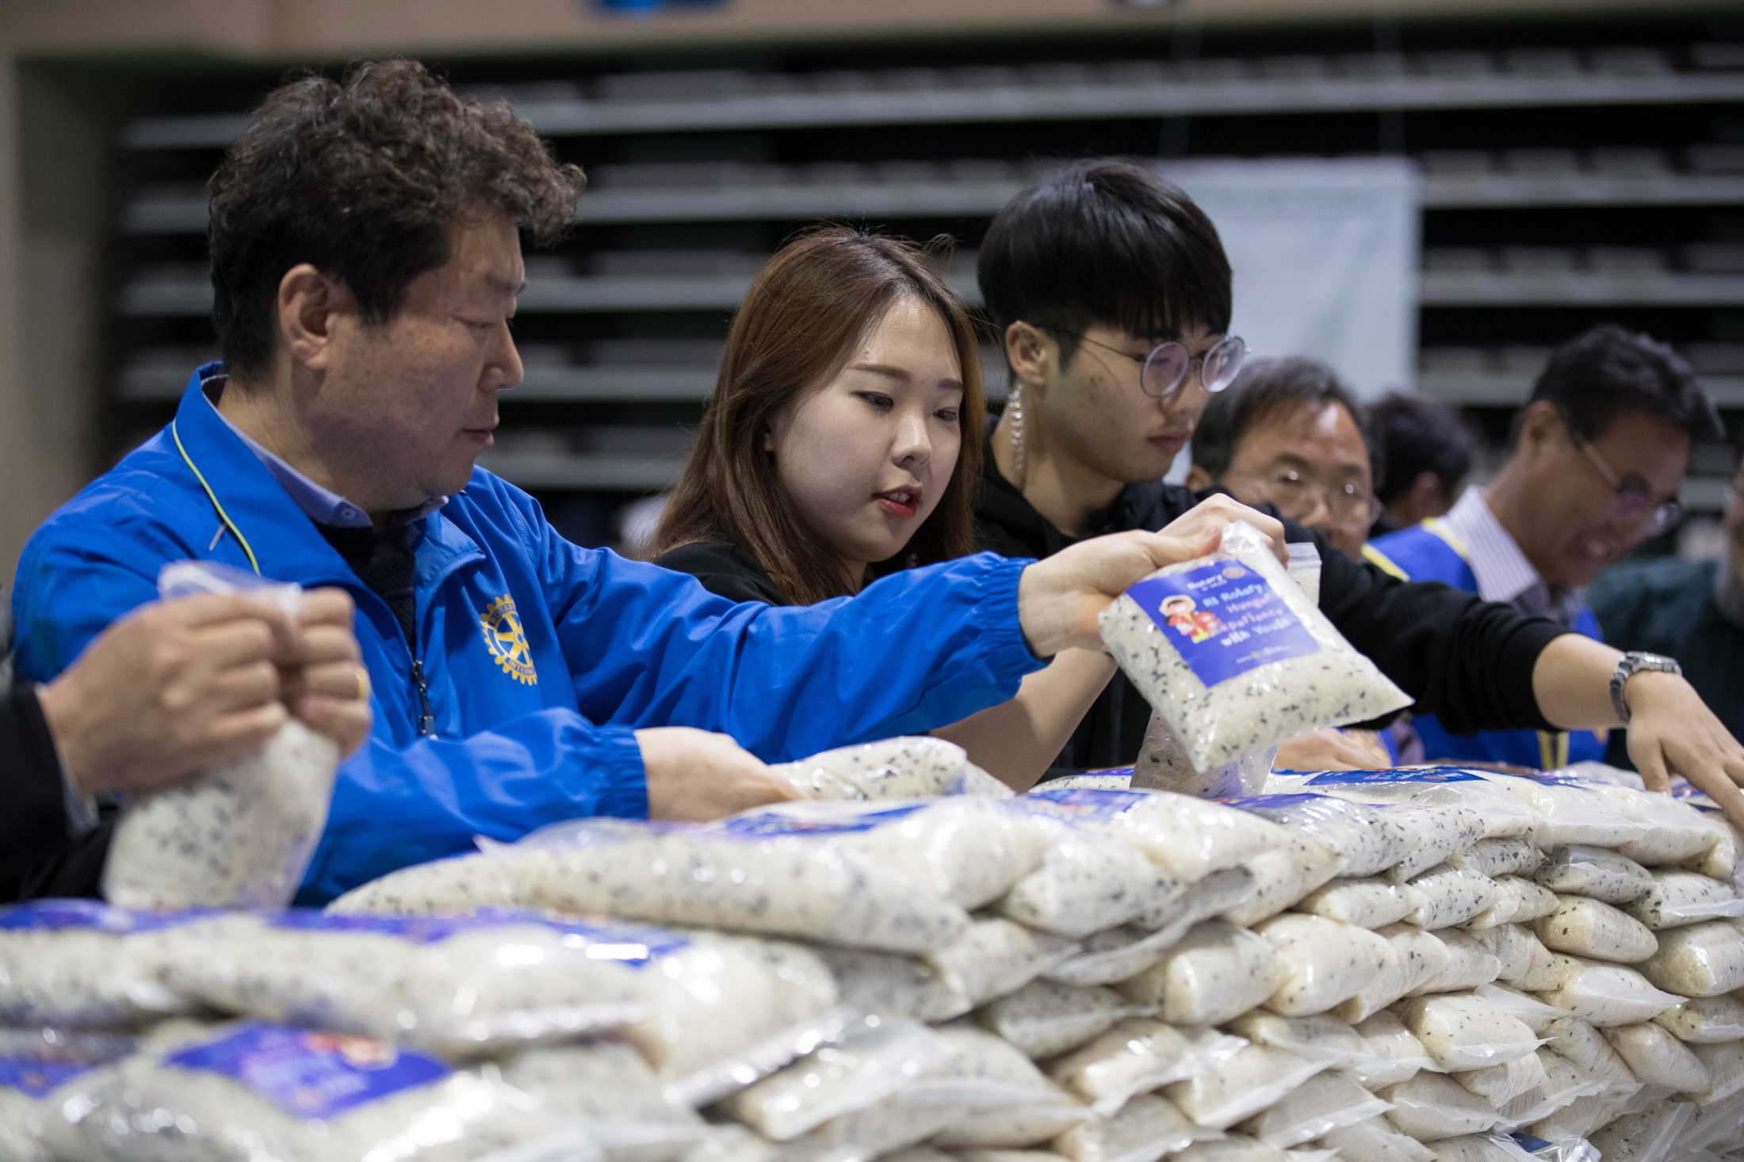
Notes:
As People of Action we strive to understand the needs of others. But just like the people and communities we serve, our fellow members need to know that they are seen, heard, and valued. They’re seeking experiences that feel personally and professionally relevant and fulfilling and, in some cases, we are not delivering on that need. This priority is aimed at making sure that we give our members meaningful opportunities to evolve and grow with us — personally and professionally — throughout their lives.

Slide 40

Notes:
But let’s not stop with our members. We want to improve the overall Rotary experience for anyone who affiliates with us. And we should take nothing for granted. We need to look at every encounter as an opportunity to show our people what Rotary can do for them — as individuals and as members of our communities.

Slide 41
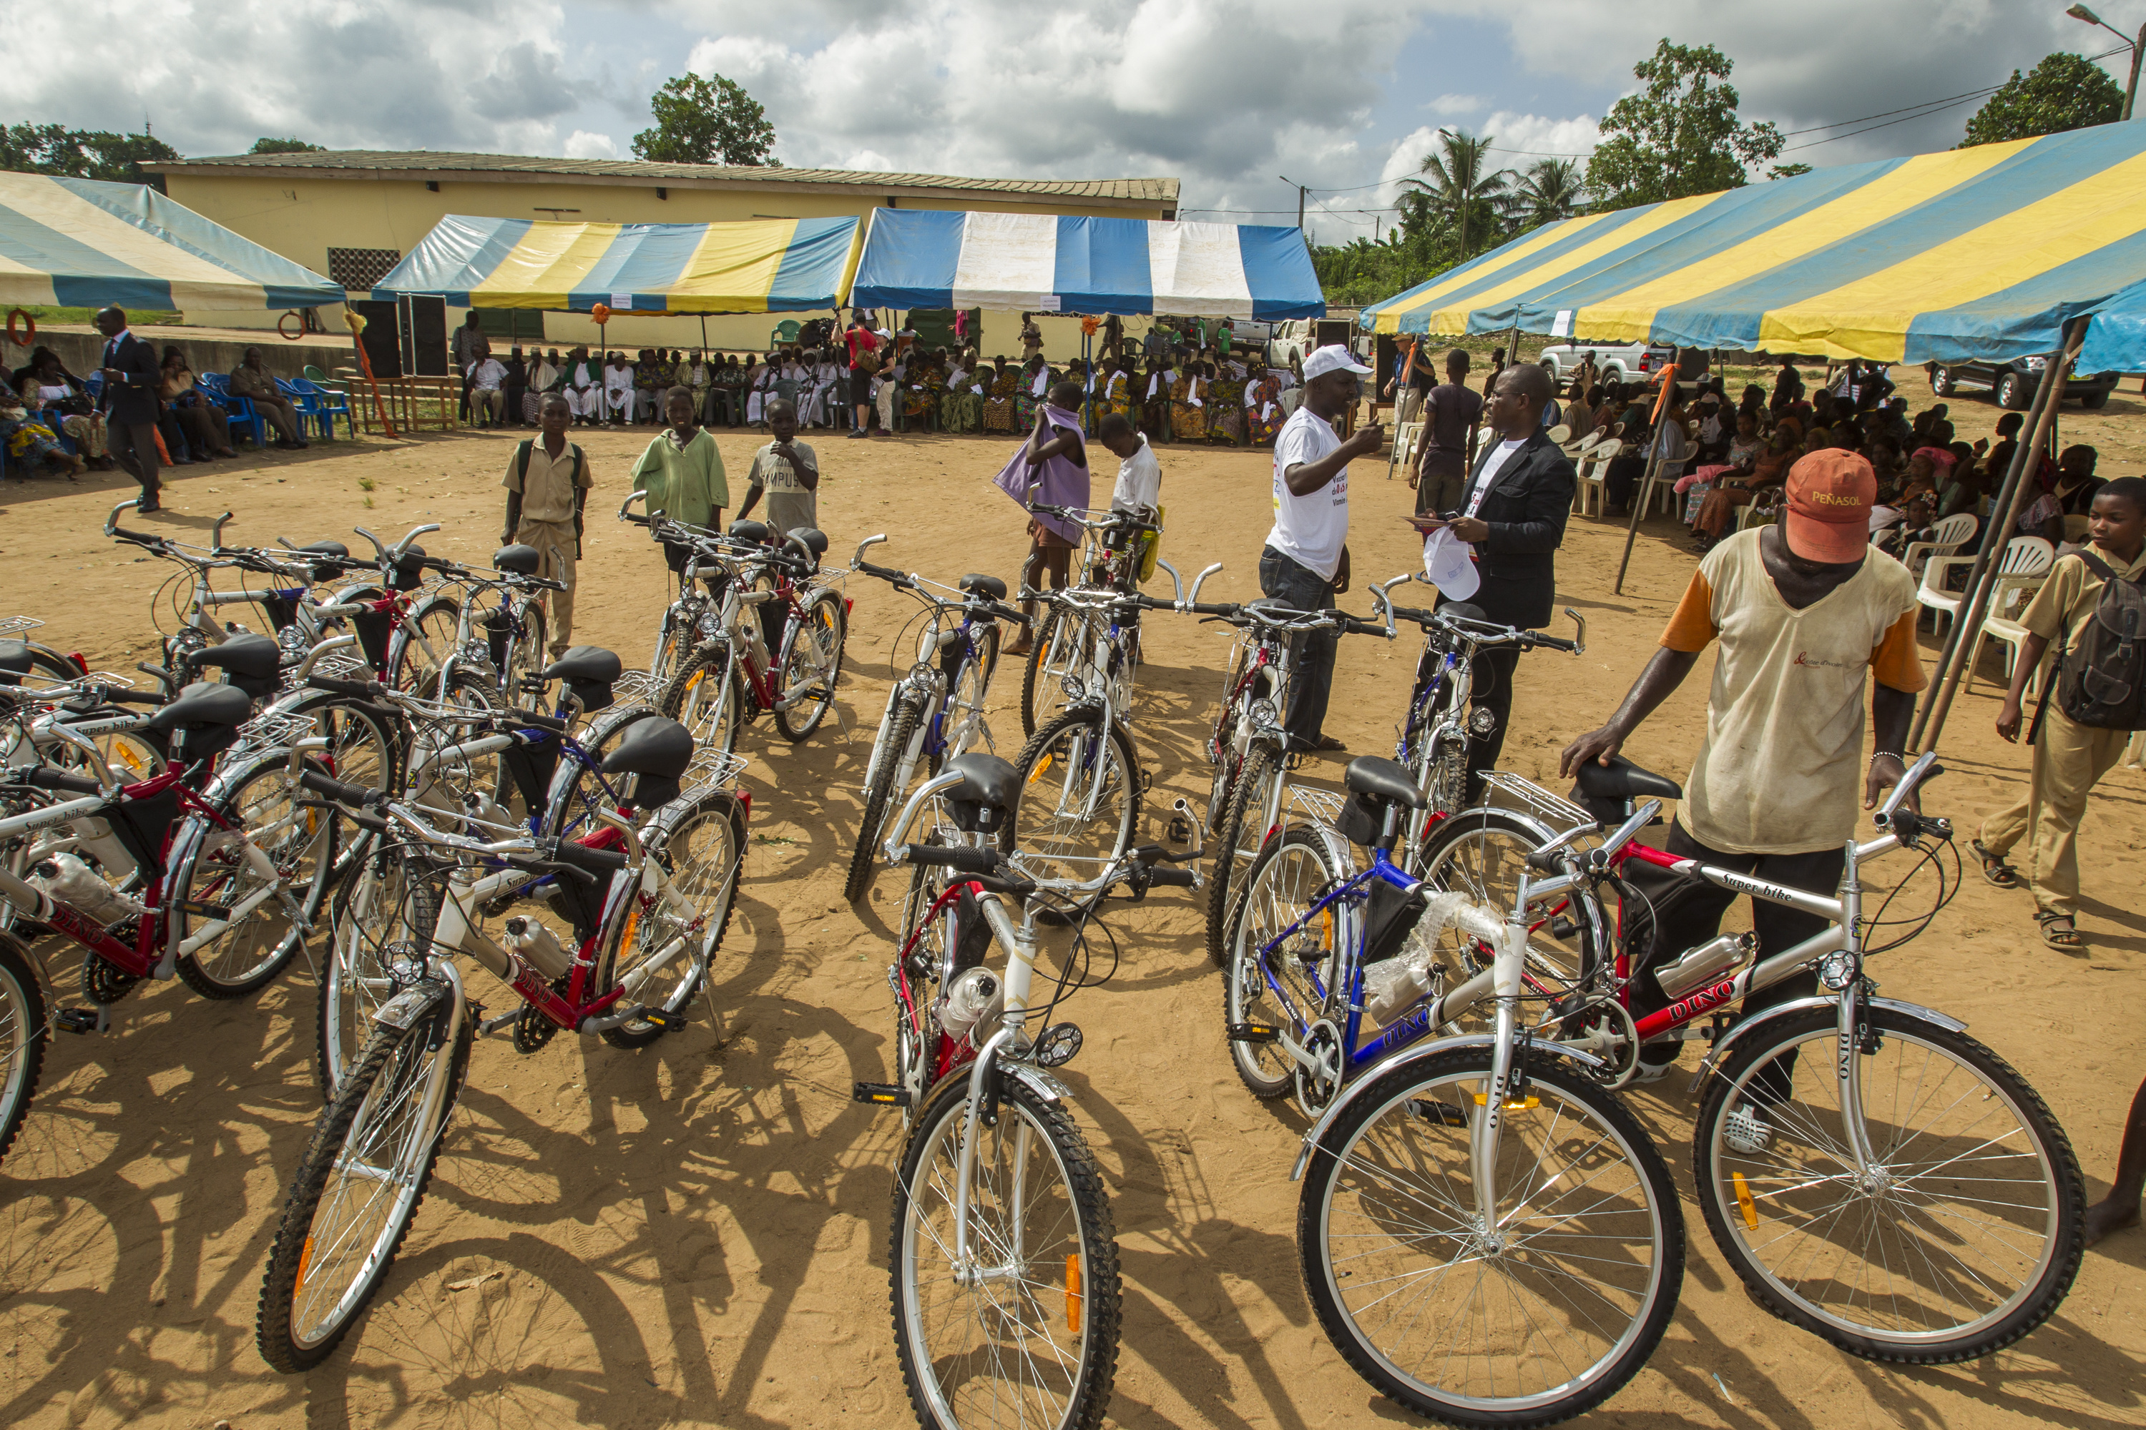
Notes:
Let’s create the space for members, participants, and the community at large to provide regular feedback on their experiences and needs. Let’s not wait for a community need to present itself to us: let’s be proactive and become known as the people who spot opportunities for positive change that no one else sees.

Slide 42
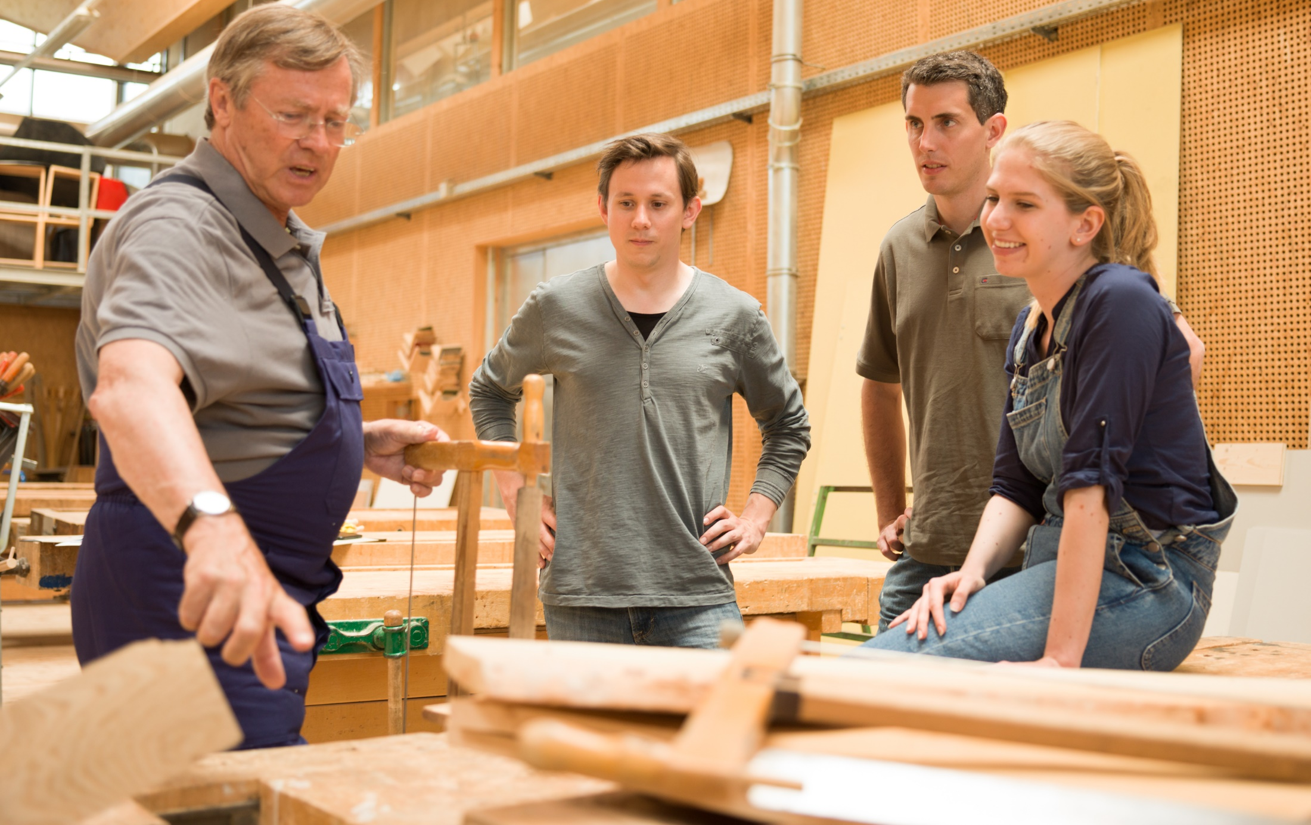
Notes:
And let’s take a hard look at what happens when people volunteer with us or attend our events. Are we doing everything we can to say, “We’re thankful you’re here. You matter to us”?

Slide 43

Together, let’s recommit to
putting the needs, expectations,
and growth of our participants
at the center of all we do.

Slide 44

ACTION PLAN PRIORITY 4:
INCREASE OUR ABILITY
TO ADAPT

Slide 45
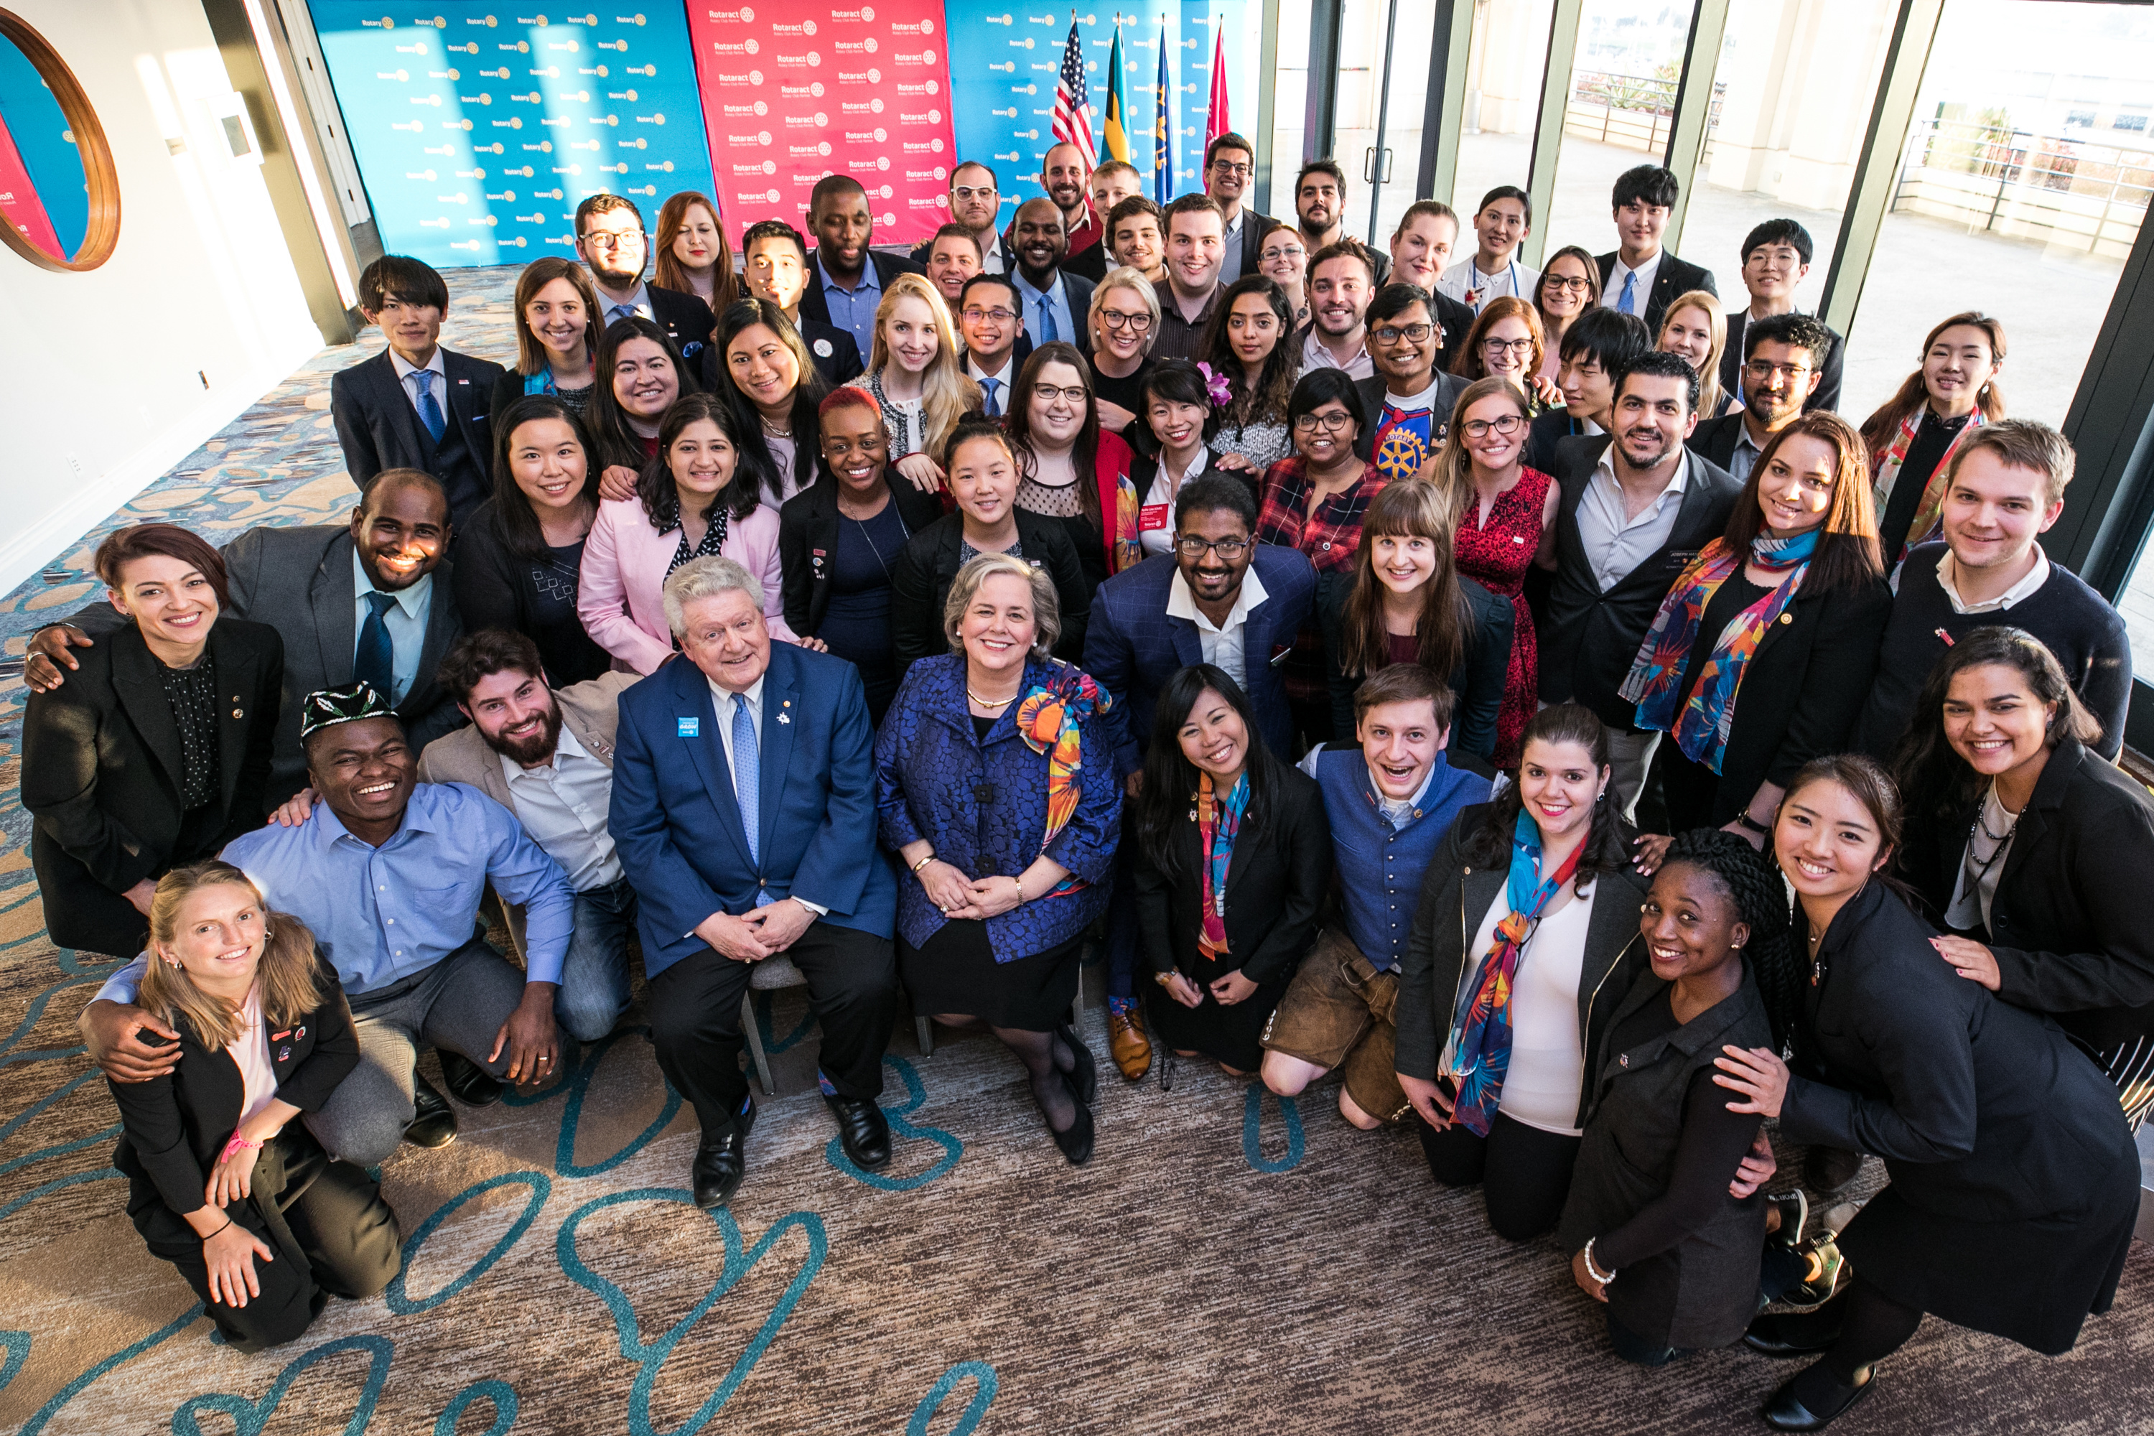
Notes:
We are inventive, entrepreneurial, and resilient. That’s why we’re People of Action. And because we share those qualities, new approaches to our organizing principles won’t threaten our sense of who we are.
It’s time for us to seek out fresh opportunities, to embrace innovative ideas and take calculated risks. We must create more paths to leadership, welcome new voices, and simplify how we operate.

Slide 46
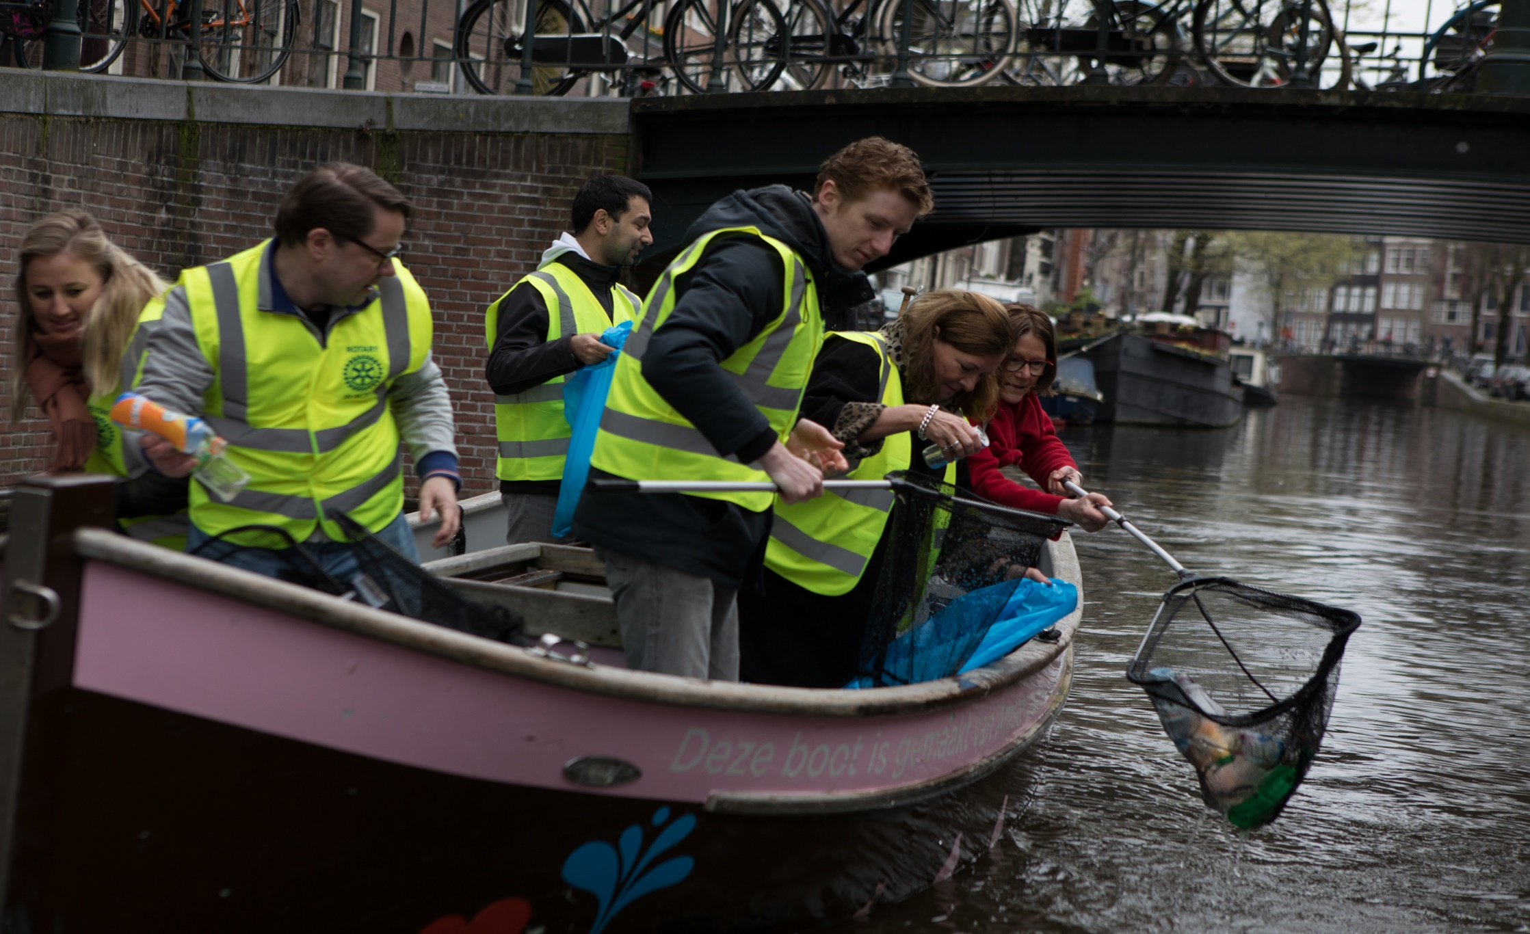
Notes:
We’re already tackling some of the big operational issues. We’re going to look at governance models, committee structures, business processes at the Secretariat level, and more. Everything is on the table.

Slide 47
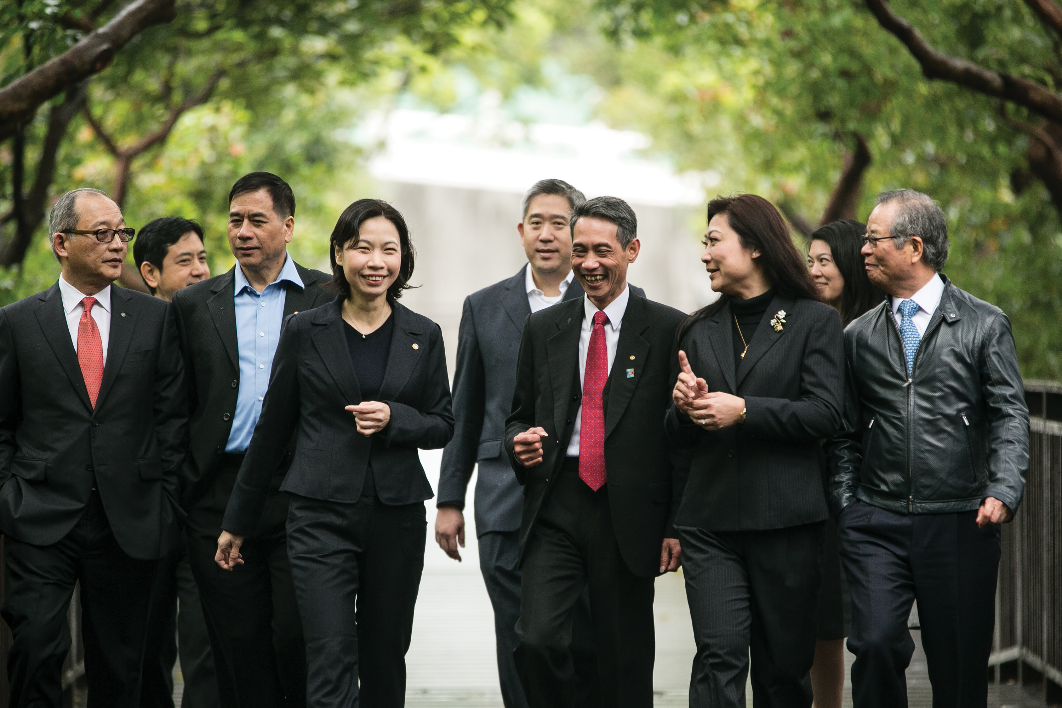
Notes:
Now, many of you have been through this kind of deep dive into internal processes in your own companies and organizations. You know it isn’t glamorous. But you also know it’s absolutely essential if we want to create a strong foundation for innovation, sustainability, and growth.

Slide 48
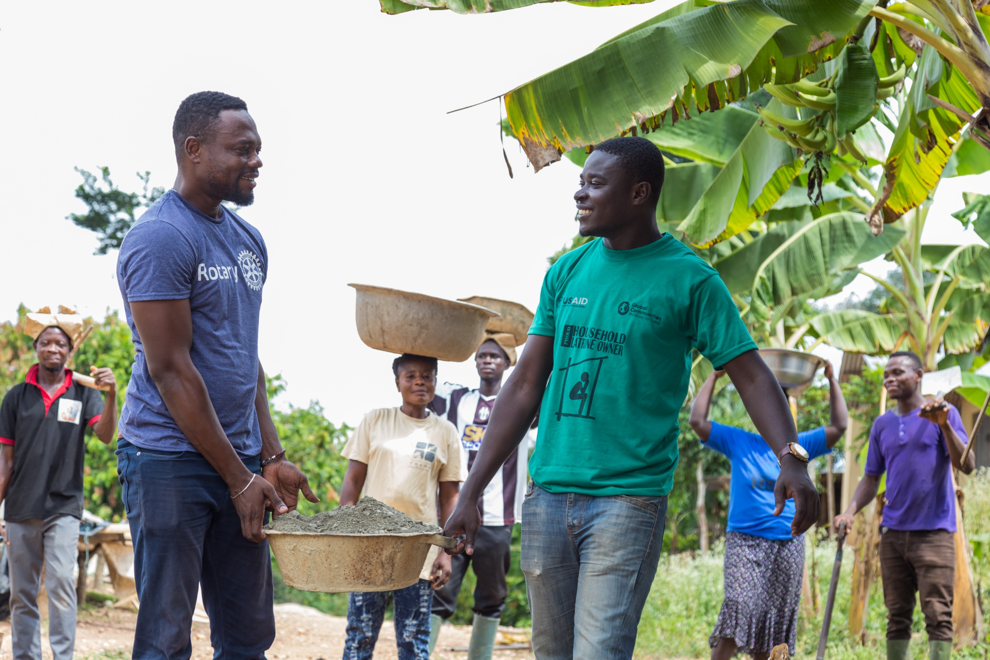
Notes:
We should also encourage our clubs to take a fresh look at club governance and look at ways to streamline it. They can create a fund to take some risks and try out new activity ideas. They can host the club meeting in a new location and at a new time. They can involve non-Rotarian advisers in club board meetings to gain new and different perspectives and ideas.

Slide 49
Together, let’s stay true to ourselves
and stay ahead of change
in our next 115 years.

Slide 50
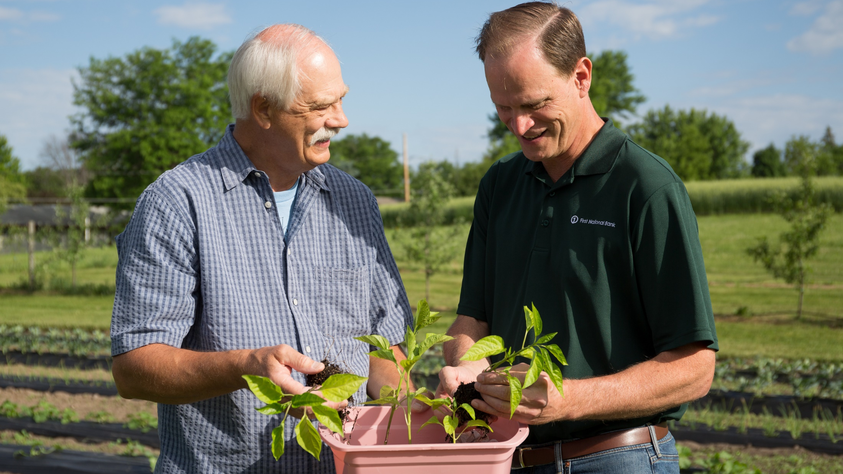
Notes:
Now that I’ve shared more about our collective vision for the future, I hope you see how this Action Plan speaks to all of us, at every level of Rotary. And I think now you see that while each one of these priorities must be owned by all of us, we don’t have to address them in the same way.

Slide 51
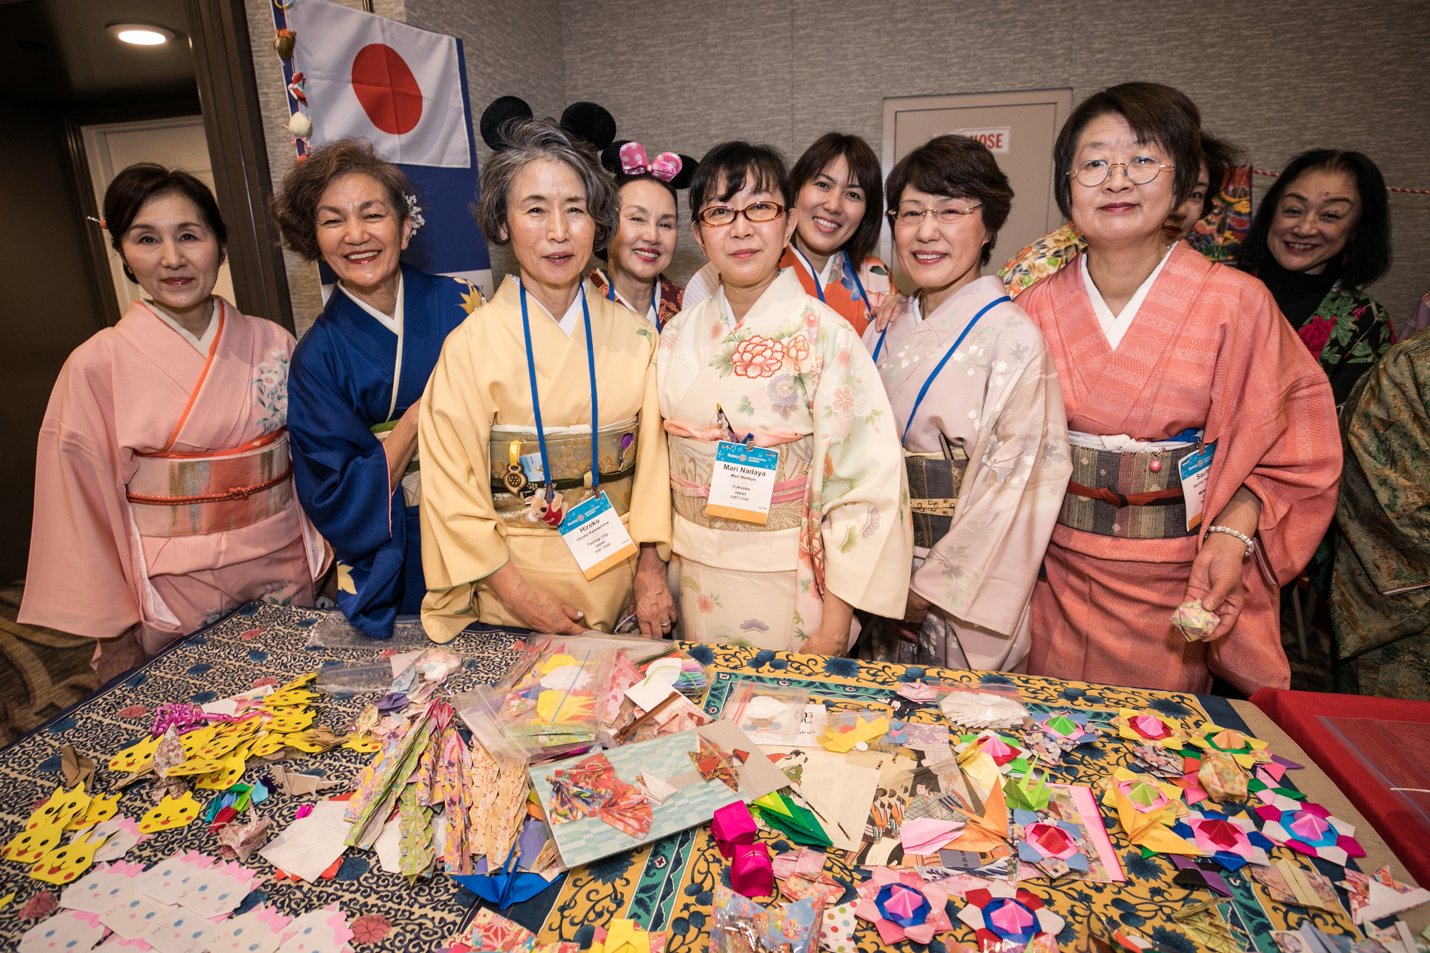
Notes:
Let’s play to our strengths as leaders, as clubs, and as members. There is much we can do at the corporate level in terms of operations and infrastructure. And there is much that can be done at the club and person-to-person levels so that every person who engages with us has a meaningful, valuable, and fulfilling experience. Working together, doing what each of us does best, we can make a stronger Rotary, and change more lives and communities for the better.

Slide 52

Notes:
But for the next five years to be as transformative as we need them to be, each and every one of us is going to have to take on the role of Action Plan Champion.

Slide 53
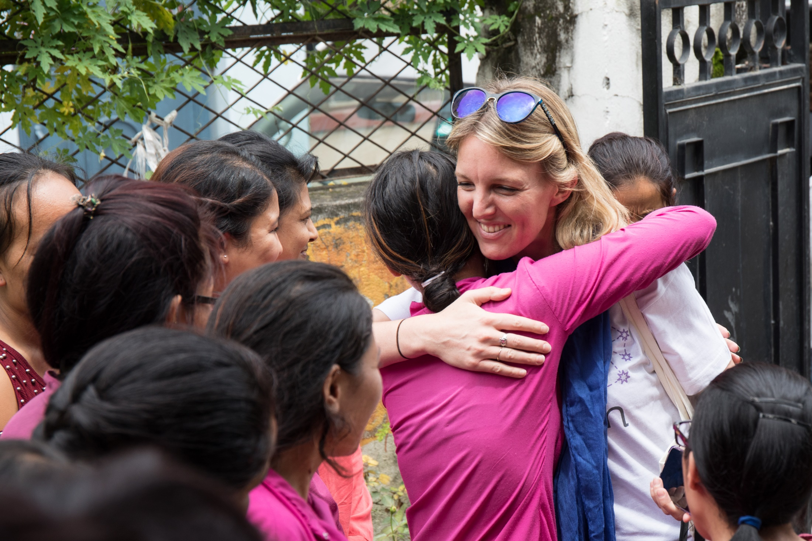
Notes:
I know you can do it, because you’ve already proven yourselves to be just that: real champions. Champions in the way you advocate for Rotary, champions of leadership, and champions of inspiration.

Slide 54
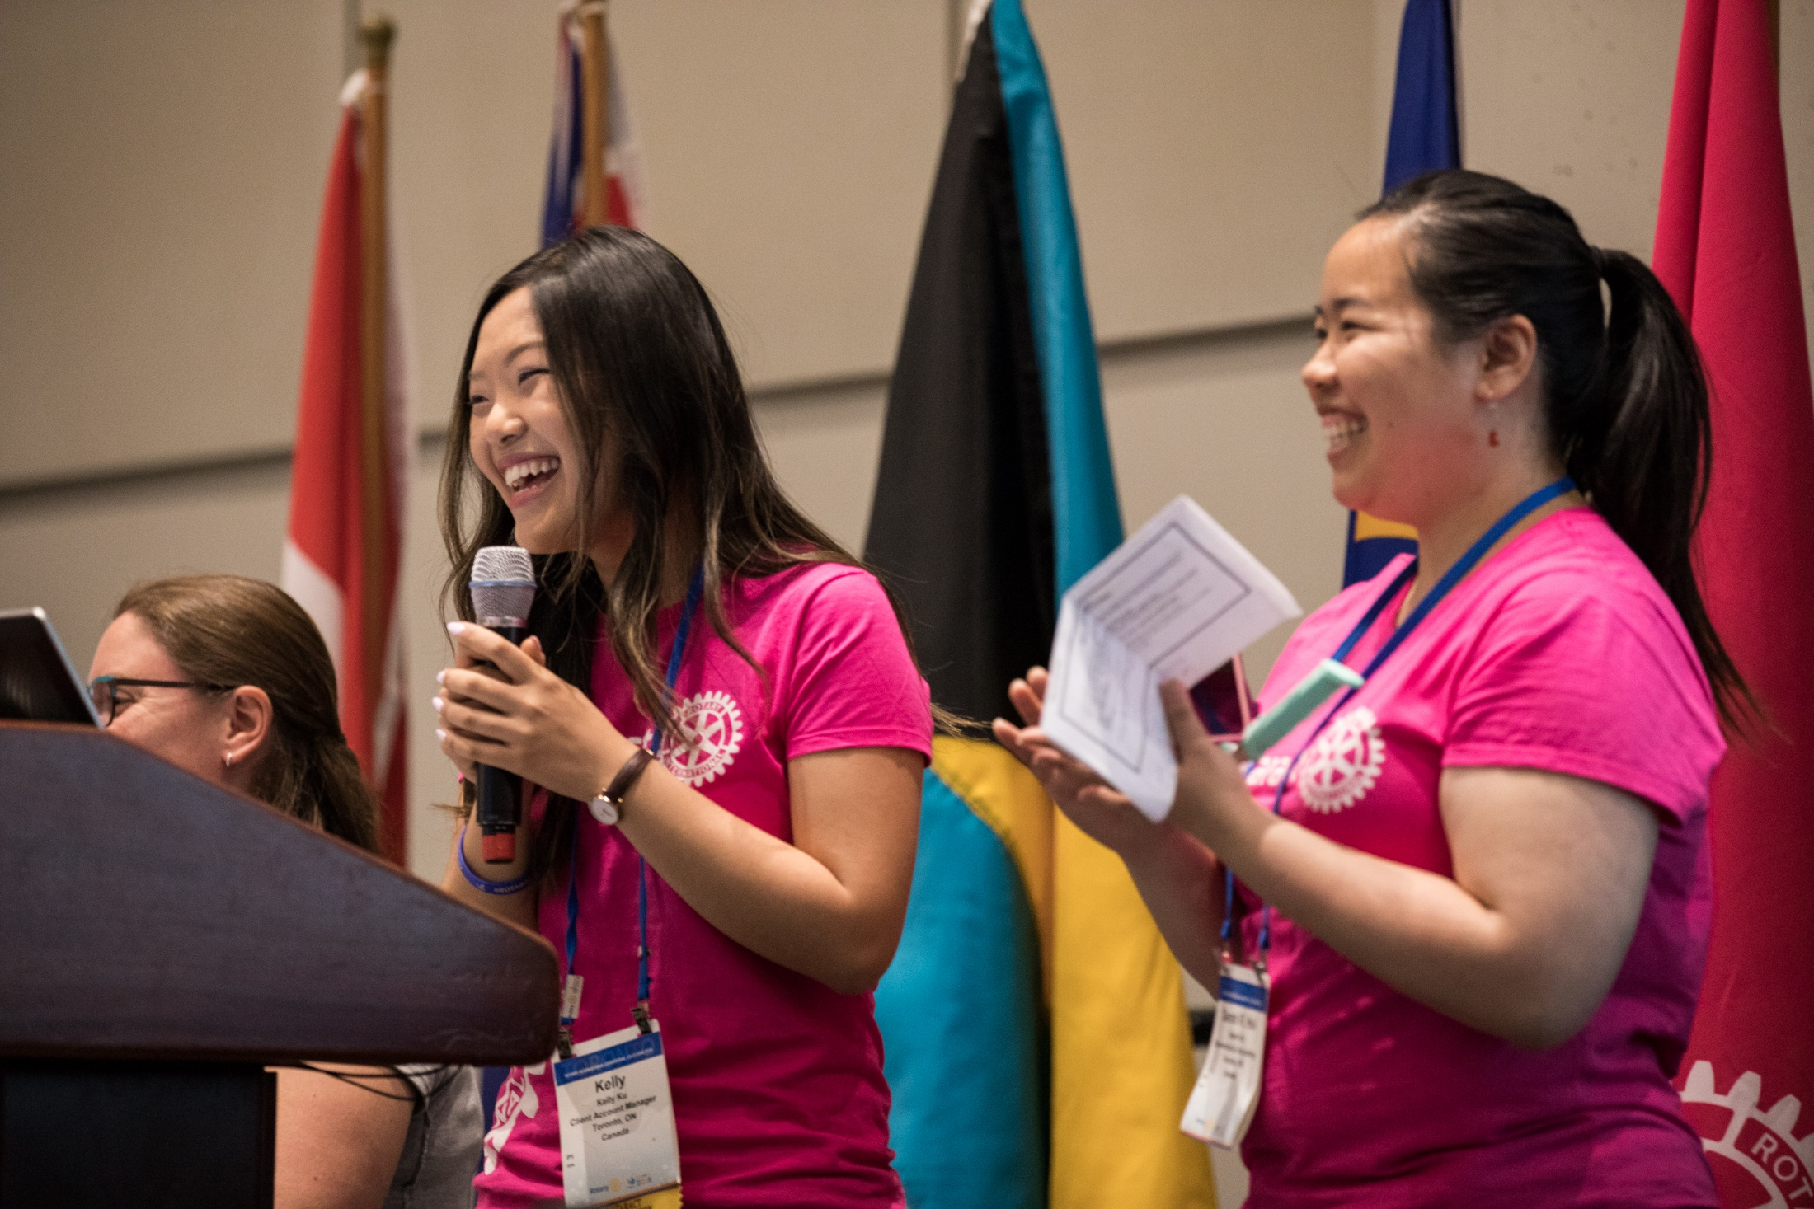
Notes:
As Action Plan Champions, we will set the example by responding to change, actively shaping Rotary’s culture, and guiding Rotary through the next century of service.

Slide 55
rotary.org/actionplan

Slide 56
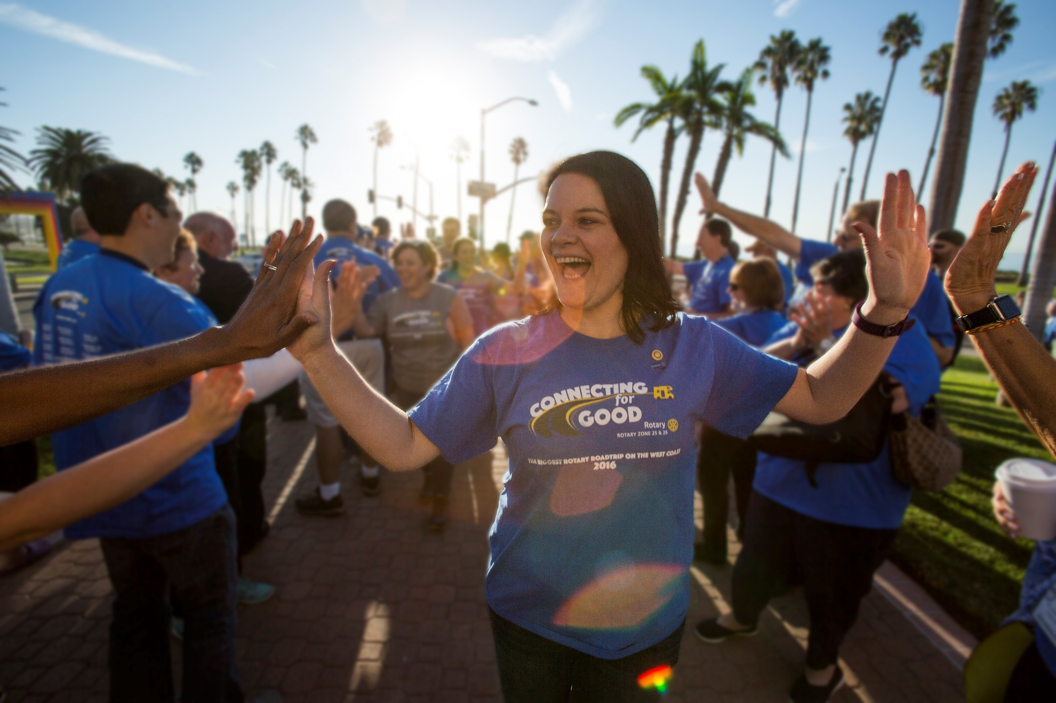
Notes:
To my fellow Action Plan Champions, thank you for your dedication to Rotary. Together, let’s carry out Rotary’s vision of a better world. Let’s show the world what it means to be People of Action.

