Slide 1
Notes:
Hello and welcome to this presentation on The Rotary Foundation’s Cadre of Technical Advisers.

Slide 2
[PRESENTER
NAME]
Notes:
My name is __________, and I am [a Cadre adviser in the x area of focus/financial auditing, district/club officer, staff title, etc.].
*To change the image to your headshot, click to select it, then go to the ‘Picture Format’ menu and select the ‘Change Picture’ dropdown to upload a different image.

Slide 3
Notes:
The Cadre of Technical Advisers is known as Rotary’s Project Planning Experts – which we’ll talk more about during this presentation.

Slide 4
Notes:
To begin, I’d like to show a short video to introduce the Cadre.

Slide 5
WHO ARE THE CADRE?
500+ advisers
75+ countries
80 languages
Volunteer Rotary members with professional expertise in Rotary’s areas of focus or financial auditing
Notes:
Now, I’ll expand on the overview provided in the video.
The Cadre is a group of volunteer Rotary members with professional expertise in Rotary’s areas of focus, as well as financial auditing.
The mission of the Cadre is to strengthen the impact of Rotary by advising Rotary members on projects and conducting grant project evaluations to help safeguard The Rotary Foundation’s funds.
There are more than 500 Cadre members from over 75 countries who speak 80 languages.

Slide 6
WHO ARE THE CADRE?
Current, active Rotary member in good standing
2+ years relevant professional experience
Complete required Learning Center courses
Apply in the Grant Center
Notes:
Any Rotary member with the requisite experience can apply to become a Cadre adviser in the Rotary Grant Center.
To become a Cadre member, individuals must be a current, active member of a functioning Rotary or Rotaract club, be in good standing with The Rotary Foundation and Rotary International, have two years of professional experience in one of the seven areas of focus or financial auditing, and complete courses in the Learning Center.
Do you have any questions about these requirements?

Slide 7
ORGANIZATION BY SECTOR
At a glance
200 doctors, nurses, public health experts
150 accountants and auditors
110 agricultural, microcredit, and economic development experts
100 hygiene educators and clean water specialists
70 environmental professionals
50 educators and literacy specialists
40 mediators and peacebuilders
FINANCIAL AUDITING
Notes:
The Cadre and its members are organized by technical sector and region to help foster collaborative efforts.
The Cadre has eight technical sector groups, one per each area of focus plus financial auditing. To the right you can see a snapshot of Cadre members’ specializations.
Each of the eight groups is led by appointed technical coordinators. Technical coordinators have extensive technical and project development experience, as well as strong familiarity with the Cadre and Foundation programs. They consult with Foundation area of focus staff, Rotary Action Groups, and other partners in their technical areas to increase collaboration and share best practices with their Cadre adviser groups.
.

Slide 8
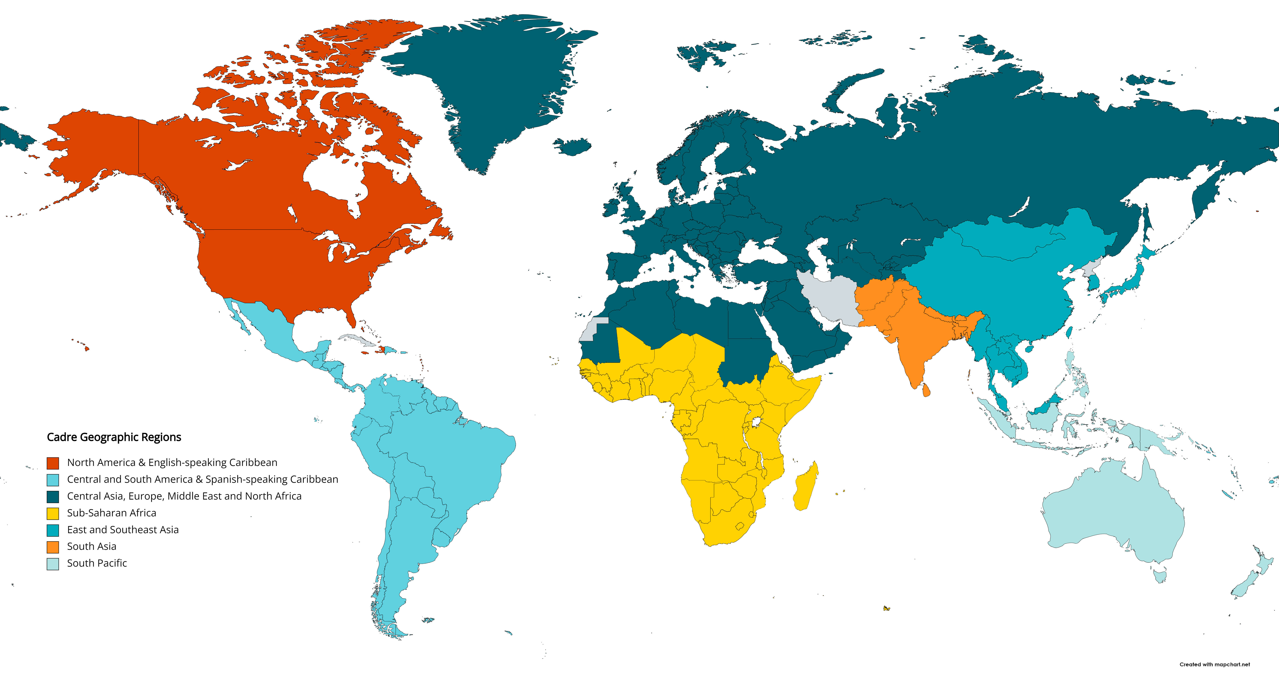
CADRE ORGANIZATION -Geographic Regions
Cadre Geographic Regions
 | North America
 | Latin America
 | Central Asia, Europe, Middle East, North Africa
 | Sub-Saharan Africa
 | East and Southeast Asia
 | South Asia
 | South Pacific
REGIONAL ORGANIZATION
Notes:
Cadre advisers are also organized into seven regions, as shown on the map. Each region is led by a Cadre regional organizer who focuses on strengthening local connections, building relationships between the Cadre and their region’s club, district and regional leaders, and mentoring.

Slide 9
Cadre members
EVALUATE and ADVISE
Notes:
Now that we have a better idea of who Cadre members are, let’s talk more about what they do.
The two main roles of the Cadre are to
assist The Rotary Foundation with the evaluation of Rotary grants and
help Rotary members with the planning and implementation of projects.

Slide 10
Do you have experience with the Cadre?
Notes:
Before we discuss these roles in more detail, I’m curious – have any of you been involved in a Cadre site visit or collaborated with a Cadre member on a project? [Scan the audience for head nodding, hands raised, or other acknowledgement. If you see a response, feel free to ask if anyone would be willing to briefly share about their experience with a Cadre member on a site visit or how they helped them with a project.]
Thanks for sharing. Now, let’s talk a bit more about these roles.

Slide 11
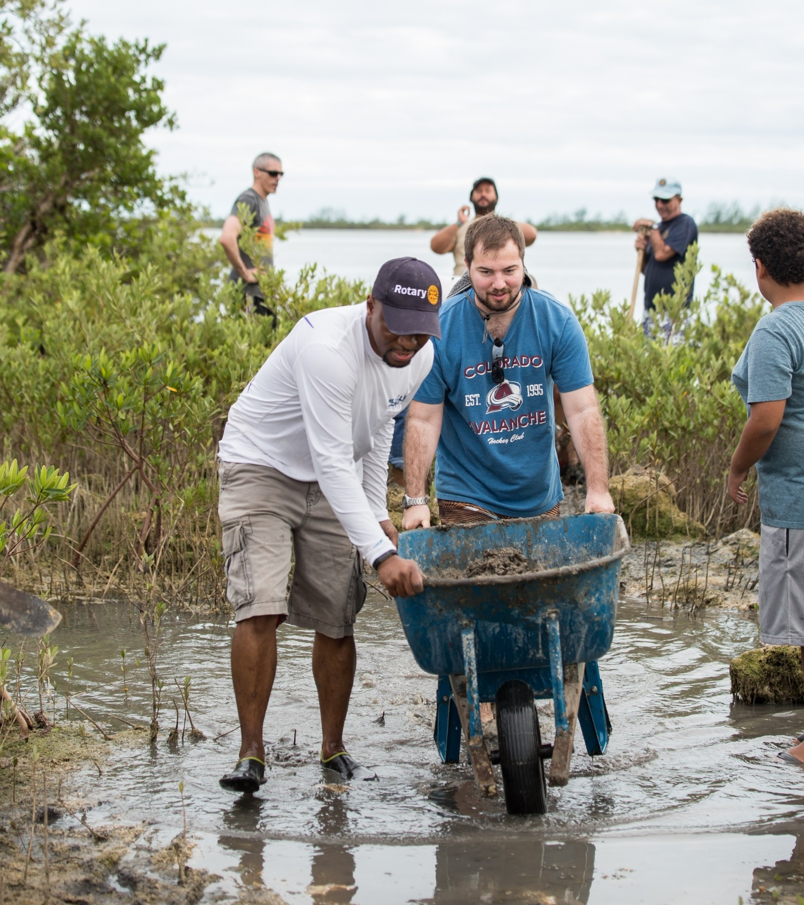
CADRE ROLES: Evaluate
Assist with Rotary Foundation evaluations
Application reviews
Site visits and audits
Special programs and partnerships (such as Programs of Scale, corporate social responsibility grants, and the Grant Model Evaluation)
Notes:
First, let’s talk about evaluation. Cadre advisers play a critical role in stewarding The Rotary Foundation’s grant funds by helping evaluate projects funded by Rotary grants.
Cadre advisers review grant applications before approval, visit project sites to evaluate implementation, and perform programmatic audits to ensure proper stewardship of Foundation funds. During an advance site visit or desk review, Cadre members evaluate the quality and feasibility of a project, while during an interim monitor visit, they evaluate implementation progress by meeting with a variety of project participants and help sponsors identify strengths and opportunities for addressing project challenges or to consider for future projects.
While Cadre members are most frequently used for global grant reviews, they also also serve as evaluators for other grant types including disaster response, corporate social responsibility, and district grants as well as organizational programs and partnerships, including Programs of Scale, the Grant Model Evaluation, the Rotary Healthy Communities Challenge, and more.

Slide 12
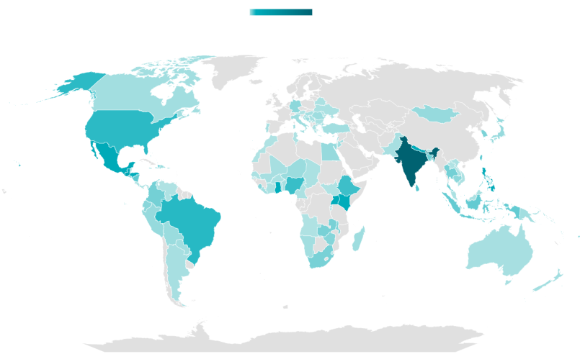
CADRE EVALUATIONS RY13-22
Count of Projects Reviewed
Low High
Notes:
Throughout the 2013-2022 Rotary years, Cadre reviewed more than 1500 global grant projects across all areas of focus, taking place in over 100 countries. Of these visits, more than 400 took place in India, followed by 78 in Guatemala and more than 50 in Nepal, the Philippines, and Mexico.

Slide 13
CADRE ROLES: Advise
Community assessment
Project planning
Implementation and monitoring
Evaluation, learning, and
possibly scaling
Advise Rotary members throughout the project cycle
Notes:
Cadre members are an invaluable resource in evaluating projects and ensuring stewardship of Foundation funds. However, Cadre members do so much more.
As mentioned in the video I showed earlier, Cadre members also play a key role in advising Rotary members on their projects.
Cadre members have instrumental knowledge that Rotary members at the club, district and regional level can leverage. Their technical, cultural, project planning, implementation, and evaluation expertise can enhance the quality and sustainability of Rotary projects. Most Cadre members also have experience with the global grant application process or can connect you to fellow Cadre members that do.
Working with a Cadre adviser with relevant skills early in the project planning process can help clubs better align their projects to the area of focus requirements for global grants. Cadre members often advise during the planning and application phase, but also may coach members throughout the rest of the cycle--during implementation, monitoring and evaluation, and efforts to determine whether projects are ready to scale to increase impact.
The Cadre is diverse in specializations and geographies. Whether you’re planning a microfinance project in Colombia or a malaria prevention project in Indonesia, there’s a Cadre adviser that can help you.

Slide 14
Need help on a project?
Notes:
Are any of you working on a global grant or other project and think you might want support from a Cadre member? [See if anyone is responsive to this question then move to follow up questions.]
What kind of project is it?
Is there something in particular that you need help with?
Suggested responses:
Great! I am confident there is a Cadre adviser who may be able to help with that.
Interesting. I think there might be Cadre advisers who specialize in that.

Slide 15
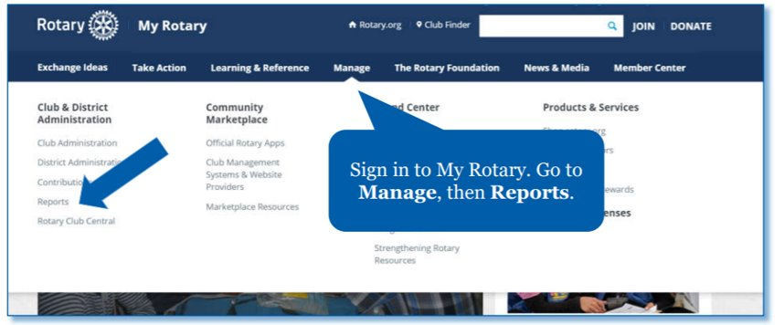
FINDING AN ADVISER
District Resource Network
My Rotary
Cadre Member Information report
Cadre Leaders Directory
cadre@rotary.org
Notes:
Rotary members can request project advising support from a Cadre member in several different ways, including:
through district resource networks, which are managed by district international service chairs
using the Cadre Member Information report on My Rotary to find a Cadre member in a relevant area of focus, language, or geography and reach out to them directly
contacting a Cadre leader listed in the directory posted on the Cadre My Rotary page for help identifying a relevant Cadre member
or emailing cadre@rotary.org

Slide 16
OTHER SUPPORT
Develop localized project resources
Facilitate at regional and district events
Support district resource networks and grant processes
Notes:
Cadre members can also support member by developing locally relevant resources and facilitating learning sessions on best practices for Rotary grants and projects at Rotary events, such as Institutes, district conference, and project fairs.
They can also support the development of district resource networks and participate in district review and approval processes for grants.

Slide 17
QUESTIONS?
Notes:
I hope this overview was helpful. Does anyone have any questions?

Slide 18
THANK YOU
cadre@rotary.org for Rotary staff
Cadre Leaders Directory
Notes:
Thank you for inviting me to present today. If you have additional questions about the Cadre, I encourage you to contact the Cadre regional organizer for your geographic area or email cadre@rotary.org.
I’ve also included my contact information if you would like to speak with me further. *Presenter(s), feel free to add your name/contact info if you are comfortable

